Slide 1
Local Use of TRICS: A Case Study from a User’s Perspective
Ewan Anderson, Fore Consulting Limited

Slide 2
Contents
Two examples of recent projects:
Harlow Grange, Harrogate (124 dwellings).
Clifton Gate, York (3,400 dwellings).
Look at where TRICS works well and where it is currently limited.
Is TRICS appropriate when working on large/strategic sites?
Some questions for TRICS (and users) going forward.
Notes:
In this presentation I am going to provide two examples of recent projects that we have worked on. I’ll provide a brief overview of each, then run through how we have used TRICS and the outputs that it has given us.
What I am hopefully going to do, is to identify an area where we feel that TRICS works well, but also, importantly, where we feel that it is perhaps currently limited. In particular, I am going to look at whether the use of TRICS is appropriate for large-scale, strategic sites, at present. The intention is to raise a few questions for TRICS going forward and to generate a bit of thought amongst yourselves.
Obviously, this is only one local user’s perspective, so it will be interesting to see if you agree or not, and I am sure you will have plenty of other ideas.

Slide 3
Project 1: Harlow Grange, Harrogate
Notes:
Okay, the first example I going to give you is a project called Harlow Grange, Harrogate, which we recently worked on. The commission was to prepare a Transport Assessment and a Travel Plan to support the outline planning application.

Slide 4
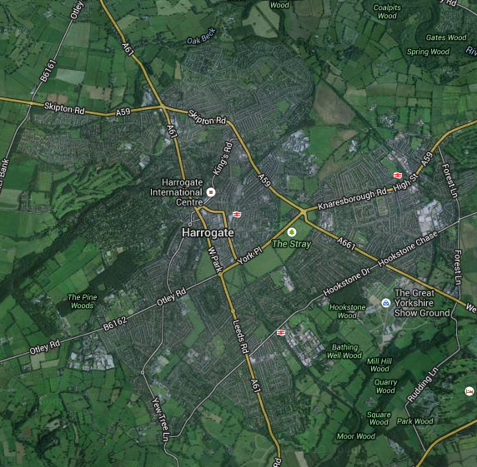
Overview
Proposed development of 124 residential dwellings.
Approximately 3.0km southwest of Harrogate Town Centre.
Immediately north of B6162Otley Road.
Notes:
As you can see, the project was for the proposed development of 124 residential dwellings, right at the western edge of Harrogate, approximately 3 kilometres from the town centre.

Slide 5
Use of TRICS
TRICS used to derive average person trip rates (‘Multi-Modal Total People’) for the proposed development.
Database interrogated for sites based on the following criteria:
Land Use | 03 – Residential
Category | A – Houses Privately Owned
Location | Edge of Town
Trip Rate Parameter | Number of dwellings
Range Selected by User | 93 to 155 Dwellings (ie +/-25% of the proposed development)
Actual Range | 98 to 155 Dwellings
Survey Days | Monday to Friday
Travel Plan | No
Calculation Factor | 1 Dwelling
Notes:
For this site, as with most projects that we work on, we used TRICS to derive average person trip rates, from which we estimated vehicular trip rates and, therefore, the likely traffic generation associated with the proposed development.
As you can see, we interrogated TRICS for sites based on the following criteria:
Residential.
Houses Privately Owned.
Edge of town.
Number of dwellings.
Etc.
The table is not exhaustive, but does give some idea of the search approach undertaken.

Slide 6
Use of TRICS
Estimation of vehicular trip rates:
Person trip rates from TRICS applied to the car driver mode share for the local ward.
Harlow Moor ward (‘Method of Travel to Work’, 2011 Census) = 64%.
TRICS is considered to work well for projects of this type.
Large number of similar sites available.
Options to tailor search criteria to match proposed development.
Land Use | Unit | Trip Rates (Vehicles/per unit)
 |  | Weekday AM Peak Hour |  | Weekday PM Peak Hour
 |  | Arrivals | Departures | Arrivals | Departures
Residential | 1 Dwelling | 0.146 | 0.521 | 0.391 | 0.221
Notes:
Having used TRICS to derive person trip rates, we have then used mode splits from the 2011 Census, using the ‘Method of travel to work’ dataset, to estimate vehicular trip rates for the proposed development. This is the recommend approach in ‘Guidance to Transport Assessment’, and is generally accepted, and recommended, by Local Highway Authorities and the Highway Agency.
In this case, the car driver mode share for the local ward was 64%, which was applied to the person trip rates, to estimate the vehicular trip rates (which are shown in the table on the slide). The vehicular trip rates, and the resulting traffic generation, were then used to assess the likely impact of the proposed development on the highway network, with a study area identified and junction capacity assessments undertaken. The trip rates and the use of TRICS is therefore crucial, in that it underpins a lot of the technical work that we undertake.
From our experiences, with this approach and the trips rates derived, we feel that TRICS works well for projects of this type. Importantly, a large number of similar sites are available within the TRICS database and there is plenty of option to tailor the search criteria to match the proposed development, for example, by removing sites with a certain housing density or by changing the location of the search. You can therefore be reasonably confident that the trip rates derived are an accurate estimation of the development proposals.
The next project I am going to give you, however, is an example of where we feel that TRICS has some limitations, at present. And from a local user’s perspective, it will be interesting to see if TRICS can improve in this area moving forward.

Slide 7
Project 2: Clifton Gate, York
Notes:
Okay, this second example is of a project called Clifton Gate, York, which we are currently working on. The site is a new settlement, being promoted through the City of York Local Plan process, and is included as a draft allocation.

Slide 8
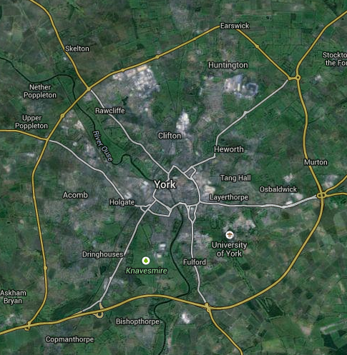
Overview
Located:
North of the A1237 Outer Ring Road at Clifton Moor.
Approximately 5.0km northwest of York City Centre.
140 hectares of land.
Notes:
The project is similar to the previous example, in terms of a residential development, in Yorkshire, located on the boundary of a major urban area; but with a significant difference in terms of scale.

Slide 9
Overview
Proposed development of 3,400 residential dwellings.
A draft allocation in the City of York Local Plan.
Sustainable new settlement, including:
Local facilities.
Social infrastructure.
Convenience retail.
Park & Ride and regular bus service to city centre.
Notes:
Specifically, the proposed development at Clifton Gate is for approximately 3400 dwellings, rather than 100-odd, and is intended to be delivered as a sustainable new settlement. It therefore includes local facilities, social infrastructure and convenience retail, as well as a Park and Ride facility and a regular bus service to the city centre.

Slide 10
Use of TRICS
Used the same approach to deriving person trips rates as for the previous example.
Provides similar search criteria:
Residential, Houses Privately Owned, Edge of Town, etc.
However, very few large residential sites within TRICS database.
Comparison of vehicular trip rates between the two projects:
Project | Trip Rates (Vehicles/per unit)
 | Weekday AM Peak Hour |  |  | Weekday PM Peak Hour
 | Arrivals | Departures | Total | Arrivals | Departures | Total
Harlow Grange | 0.146 | 0.521 | 0.667 | 0.391 | 0.221 | 0.612
Clifton Gate | 0.181 | 0.534 | 0.715 | 0.384 | 0.243 | 0.627
Notes:
For Clifton Gate, if we use TRICS, and apply the same approach to deriving person trip rates as for the previous example, we end up with a similar search criteria in terms of category, sub-category, location, etc. The one criteria that needs to differ, however, is the scale of development, which in this case is for 3400 dwellings.
Unfortunately, TRICS has very few large residential sites within its database. Indeed, there are no residential sites over 500 dwellings within the standard data range of 2005 onwards. We therefore end up with a similar set of survey sites as for the previous example, even though there are significant differences between the two in terms of the scale, nature and local facilities provided.
If we take into account the car driver mode share for the Clifton Gate local ward, which is 61% (and therefore similar to the previous example), a comparison of the two sets of vehicular trip rates is shown in the table on the slide. As you can see, using TRICS generates very little difference between the two developments, which you would question.

Slide 11
An Alternative Approach
Origin-Destination Survey of proxy area.
ANPR cameras covered all vehicle routes into Haxby and Wigginton.
Excluded ‘through’ traffic movements.
Counted all residential dwellings.
Site (Red)
Proxy (Blue)
Notes:
For Clifton Gate, an alternative approach was adopted to estimate vehicular trip rates, given the questionability in using TRICS. Specifically, in accordance with discussions with Local Authority officers, it was identified that the existing villages of Haxby and Wigginton (as shown on the map in blue) represent a reasonable proxy to the proposed development in terms of typical traffic-generating characteristics. This includes the size of the developments, the proximity of the strategic and local transport networks, and the land uses (thereby, indicating the possible level of trip internalisation).
Consequently, an origin-destination survey of the five vehicle routes into Haxby and Wigginton was undertaken using ANPR cameras. By excluding ‘through’ traffic movements, the surveys enabled quantification of traffic movements associated with the existing residential areas and associated local facilities.

Slide 12
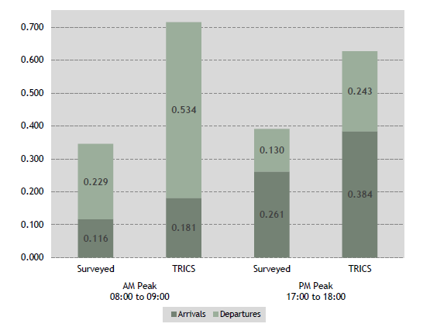
Comparison of Trip Rates
Notes:
If we compare the results from the traffic survey undertaken, with the vehicular trip rates previously provided using TRICS, we can see a clear difference. In particular, the surveyed trips rates for the existing settlements are significantly lower than those estimated using TRICS. Indeed, the trip rates are 52% lower during the AM peak hour, and 38% lower in the PM peak hour.

Slide 13
Issues from the comparison
Does the use of TRICS accurately provide trip rates for large/strategic developments, at present?
If not, can TRICS respond to this challenge moving forward, or do we need to adopt a different approach to deriving trip rates for these sites?
For example, by desegregating trips by journey purpose.
Notes:
Although recognising that this is only one example, the comparison provided does raise an important question about the suitability of using TRICS for large-scale, strategic sites.
Specifically, does the use of TRICS provide accurate trip rates for these developments, at present?
If we consider that TRICS does not - as found in this example - can TRICS respond to the challenge moving forward, or do we need to accept the limitations of the current software and adopt alternative approaches, for example, by desegregating trips by journey purpose or by using strategic transport models to generate productions and attractions.

Slide 14
A Local User’s Perspective
Increasingly working on more large-scale, strategic sites.
Brought about by changes to the national policy framework.
Changes to planning policy through NPPF.
DfT Circular 02/2013
Sites being promoted through the Local Plan process.
If not, does the use of TRICS become a barrier to development?
Overestimating the traffic generation and traffic impact on the highway network.
Extent of study area to be assessed.
Mitigation schemes required.
Notes:
If we bring the presentation right back to the concept of a “local user’s perspective”, as a company, we are increasingly working on more of these large-scale, strategic sites. Indeed, I have probably worked on four or five in the past 18 months that include more than 1,000 dwellings with associated local facilities.
With changes to the national policy framework, through the introduction of NPPF and the new Local Plan system, we are finding that more of these sites are being brought forward by developers and are being promoted through the Local Plan process. This is particularly the case in Yorkshire and the North East, where we do a lot of our work.
At present we feel that TRICS is great for use in the first example; but perhaps unsuitable for projects of the Clifton Gate type. Specifically, TRICS seems to overestimate traffic generation and, therefore, the extent of the study area to be assessed, the subsequent assessments of the highway network undertaken and, ultimately, the scale and form of any mitigation required. The use of TRICS can therefore become a barrier to development, in certain cases.

Slide 15
Questions for TRICS going forward
Does TRICS need to expand its database to include more large/strategic sites?
If so, how feasible is the collection of accurate data for these sites?
The internalisation of trips.
Multi-modal trip rates.
Phasing and build-out (10- years).
And how can these sites be integrated into TRICS?
Notes:
Okay, to wrap up the presentation, a few questions for TRICS moving forward. Specifically:
Does TRICS need to expand its database to include more strategic sites, particularly in the context of a changing national policy framework?
And if so, how feasible is the collection of accurate data for these sites, when considering factors such as the internationalisation of trips, the recording of multi-modal trips (for example, pedestrian trips), and the long build-out period of these sites (which can be 10 to 20 years).
And a final question, if new surveys are undertaken, how can TRICS integrate these sites into the existing software? Would this, for example, be the introduction of a new category or sub-category?
Hopefully, the examples provided here, and the ideas presented, will generate a bit of thought amongst yourselves about the projects that you have worked, and the cases where you have found TRICS to work well, or not.
No doubt, you will have plenty of other ideas for TRICS going forward that I have not covered.

Slide 16
Local Use of TRICS: A Case Study from a User’s Perspective
Ewan Anderson, Fore Consulting Limited

