Slide 1
One System of Trip Generation: The Merging of Databases
Kevin Travers, Hampshire County Council

Slide 2
One System of Trip Generation
TRICS Launched in 1989
TRICS and TRAIDS merged in 1992-93
GENERATE Group joined TRICS in 2007
TRICS and TRAVL merged in 2014
Notes:
In this presentation I am going to briefly talk about how TRICS has become the one system of trip generation analysis in the UK and Ireland. From when TRICS was launched in 1989, the merger of TRICS and TRAVL in the early 1990’s, the West Midlands Generate group joining TRICS in 2007, and the recent merger between TRICS and the TRAVL system of Greater London.

Slide 3
TRICS Launched in 1989
Initially launched with data from the southern TRICS Consortium counties
Initial estimate of member organisations was 30-40
Database soon populated with surveys from Greater Manchester and Lancashire
Membership of TRICS soon spread across the UK with further data being added
300 current member organisations
Notes:
TRICS has just celebrated its 25th anniversary. It was launched originally in 1989, as a collaboration of County Councils in the south of England, now of course known as the TRICS Consortium (the owners of TRICS). The initial data in the system comprised of traffic surveys undertaken within these counties, unified for the first time. At the time the system was launched, the Consortium estimated that there might eventually be 30 or 40 TRICS member organisations (the success of TRICS saw this figure quickly rise). The early database was then additionally populated with data from Greater Manchester and Lancashire, who joined TRICS and paid for licence fees through the supply of this data. This helped TRICS spread its membership base across the UK (and eventually Ireland), with further data being regularly added to the database. At this point in time, 25 years on, we now have around 300 member organisations using the system.

Slide 4
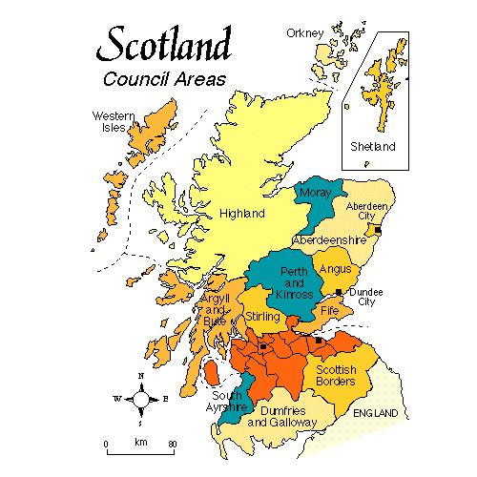
TRICS & TRAIDS Merger
TRAIDS was a similar database to TRICS covering the Scottish Regional Councils
TRICS merged with TRAIDS in 1992-93
Scottish authorities given option to supply survey data in lieu of licence fees
Notes:
In the late 1980’s and early 1990’s, TRAIDS was a database of traffic surveys similar to TRICS, but focused on the Regional Councils in Scotland. The TRAIDS Group was a collective of representatives from the Regional Councils at the time (which are now of course unitary authorities), and in the early 1990’s an agreement was reached to merge the TRAIDS and TRICS systems, with the TRAIDS data being added to the existing TRICS database and once again extending TRICS data coverage. This agreement saw the Regional Councils joining as TRICS members, with a number of them regularly supplying survey data in lieu of TRICS licence fees. It was an agreement that worked well, and representatives of TRICS regularly attended TRAIDS Group meetings in Scotland where issues of transport planning were discussed.

Slide 5
TRICS in Scotland (present day)
Data collection now split between 17 regions (of which Scotland is one)
Key Scotland survey stats (at at 2014):
Retail: 218 surveys
Employment: 86 surveys
Residential: 188 surveys
Total: 896 surveys
Notes:
The inclusion of Scottish survey data in TRICS, and the database’s overall growing regional coverage, led to distinct regional data collection programmes being undertaken annually, with these days a large annual data collection programme covering all 17 regions of the UK and Ireland. In 2014, there are currently 896 TRICS surveys within Scotland, with 218 being Retail, 86 being Employment, and 188 being Residential. There is good coverage across the other main land use categories too.

Slide 6
GENERATE Group Joined TRICS in 2007
GENERATE a similar system to TRICS covering the West Midlands region
GENERATE obtained a Corporate (multi-site) TRICS licence in 2007 covering the various local authorities:
Birmingham City Council
Coventry City Council
Dudley Metropolitan Borough Council
Sandwell Council
Solihull Metropolitan Borough Council
Walsall Council
Wolverhampton City Council
Centro
Notes:
Some years later on, in 2007, discussions took place between TRICS and the GENERATE group of local authorities in the West Midlands region. The GENERATE group had created their own database for West Midlands (called “GENERATE”), which was used on an ad-hoc “bureau” basis by the local authorities within the region. As by this time TRICS was undertaking a significant annual data collection programme within the West Midlands region, it was agreed that the GENERATE group of authorities would obtain a Corporate (multi-site) licence, covering the 7 local authorities plus Centro. This membership arrangement has remained ever since, and TRICS is now the system of trip generation in the West Midlands region.

Slide 7
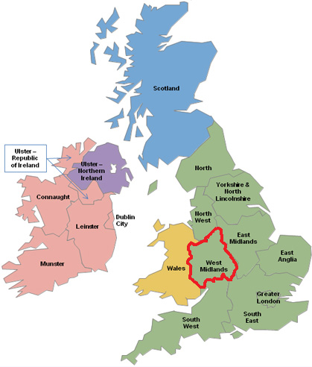
TRICS in West Midlands (present day)
West Midlands one of 17 TRICS regions
Key W. Midlands survey stats (as at 2014):
Retail: 109 surveys
Employment: 57 surveys
Residential: 74 surveys
Total: 437 surveys
Notes:
Today, the West Midlands is one of our established data collection areas, and at the latest count there are 437 TRICS surveys within the region. 109 of these are Retail, 57 are Employment, 74 are Residential, and the remainder are spread across the rest of the 16 main land use category types, themselves split between the various sub-categories.

Slide 8
TRICS and TRAVL Merged in 2014
TRAVL owned by Transport for London
Database of multi-modal surveys across Greater London
1st April 2014: TRICS and TRAVL merged through an agreement with TfL and the TRICS Consortium
Notes:
Now we can move on to the merger of TRICS and TRAVL, which took place very recently. TRAVL (Trip Rate Assessment Valid for London) is a database similar to TRICS, multi-modal in nature, and owned by Transport for London. Surveys within its database range across the various Greater London boroughs. As of 1st April 2014, TRICS and TRAVL have merged, through an agreement made between the TRICS Consortium and Transport for London. Thanks to the work of everyone involved (including Systra who were operating and maintaining the TRAVL database on behalf of TfL and who greatly assisted with the transition), there is now one unified trip generation system for London.

Slide 9
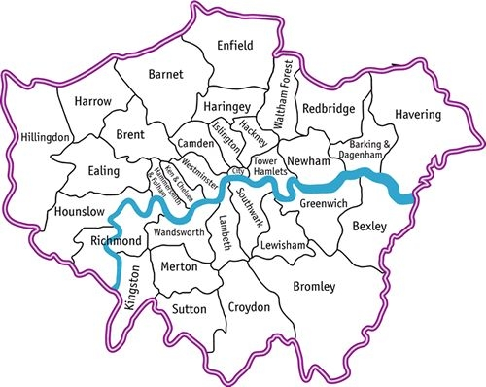
TRICS and TfL Agreement
TRAVL data extraction facility available to TRICS members
Future surveys in London to be TRICS-compliant
Increase in TRICS surveys in London
TRICS surveys in London to be enhanced
Notes:
The Agreement between TRICS and TfL was for a data extraction facility to be made available for TRAVL data, to be held within the Members Area of the TRICS website. Therefore, to access this facility, users would have to be TRICS members and logged in at www.trics.org. From 1st April 2014, the TRAVL system itself cased to be supported, although TfL hold the master copy of the TRAVL database should users need access to certain data types within it. The Agreement also stated that future surveys in London would need to be TRICS-compliant, rather than TRAVL-compliant as they used to be. It was also agreed that there would be an increase in the annual TRICS data collection programme in London, and the multi-modal surveys in the capital would be enhanced with additional count modes and count types.

Slide 10
TRAVL Data Extraction Facility in TRICS
Accessible once logged into the Members Area at www.trics.org
Main features:
Extract multi-modal count data by TRAVL land use type (tabular format)
Select start/end times for all surveys in mode count tables
Mode, Journey Purpose and Origin/Destination counts can be extracted for individual surveys
Notes:
We can have a quick look at the TRAVL Data Extraction Facility here. Once logged in at the TRICS website, the new facility can be accessed via a button. Its main features include the ability to extract multi-modal count data (by mode) for each of the TRAVL land use categories, in tabular format. Users can also select survey start and end times to show counts for set time periods within the tables, and the facility also allows mode, journey purpose and origin/destination counts to be extracted for individual TRAVL surveys. It should be noted that this new facility is not a fully functional re-write of TRAVL. It does not calculate trip rates, it just provides the raw count data for the multi-modal, journey purpose and origin destination counts. It is to be considered a historic record that will not be updated with any future TRAVL surveys, as these will no longer be undertaken.

Slide 11
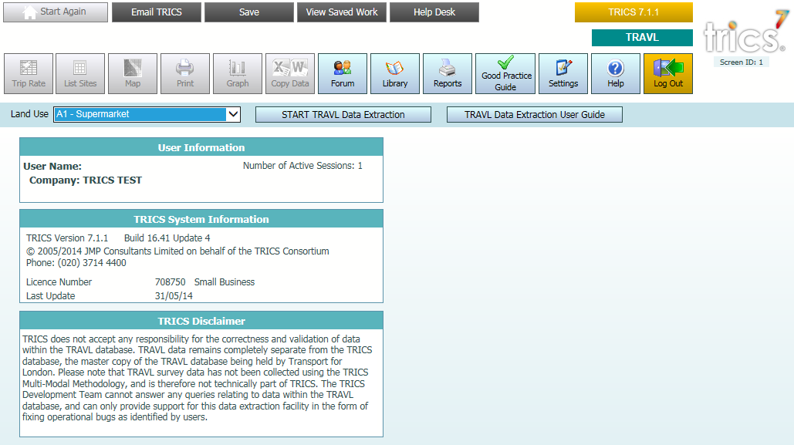
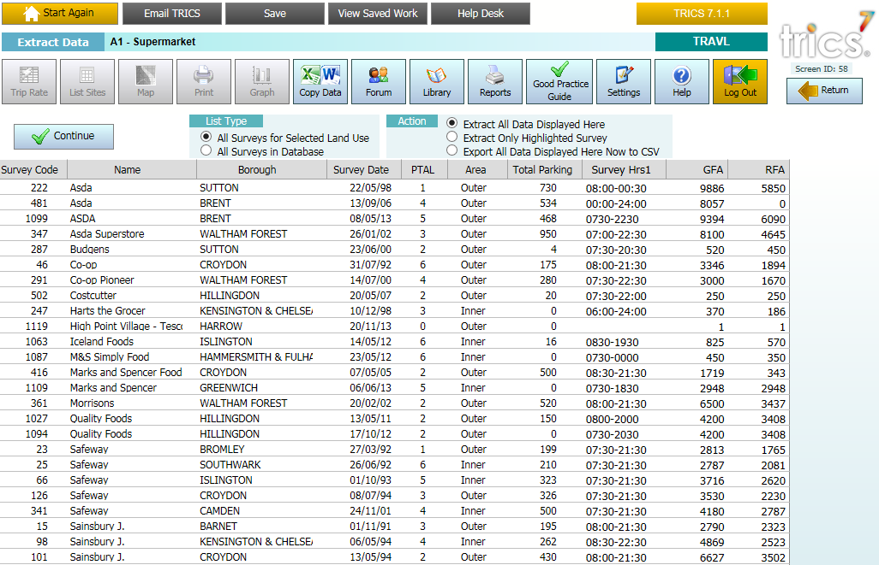
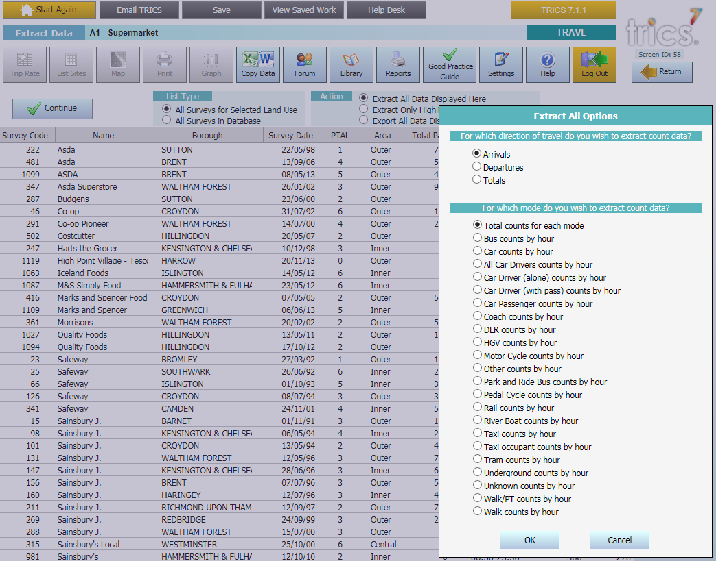
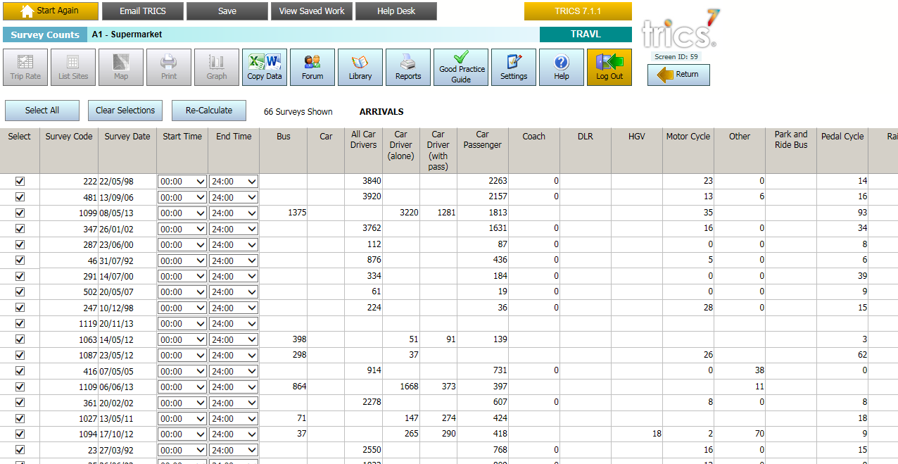
TRAVL Data Extraction Facility in TRICS
Notes:
Here are some screenshots of the TRAVL Data Extraction Facility at the TRICS website. The top left image is what users would see when they log on at www.trics.org and select to use the new facility. Here you can decide which TRAVL land use type you want to interrogate, then you can commence with the extraction. The second image (top right) displays tabular details of all survey sites within the chosen land use category (in this case food supermarkets), with information such as PTAL score, survey date, parking spaces, survey start and end times, etc. If you then choose to extract all data for the sites within the table, you go to the lower left screenshot, which shows you the mode options. In the example on the lower right image, we have selected “Total Counts for Each Mode”. You can see here that the counts by mode are displayed in a new table, and you can extract this information to a CSV file so that you can use it in Excel and undertake further manual calculations etc. This is just a quick snapshot, the facility is quite flexible and can undertake a number of different analyses.

Slide 12
Future London Surveys to be TRICS-Compliant
Previous to TRICS/TfL Agreement, surveys in London needed to be TRAVL-compliant
Following the Agreement, all surveys should now be TRICS-compliant
TfL amending Transport Assessment Guidelines accordingly
Since 1st April 2014 numerous requests for TRICS-compliant surveys have been received
Notes:
Prior to the Agreement, surveys in London needed to be TRAVL-compliant, but with the signing of the Agreement these are now being replaced by TRICS-compliant surveys. Transport for London will be amending its guidelines on Transport Assessments accordingly, and from 1st April 2014 numerous requests for surveys have been coming through to the TRICS team. Over time there will be a significant number of Greater London surveys regularly added to the TRICS database.

Slide 13
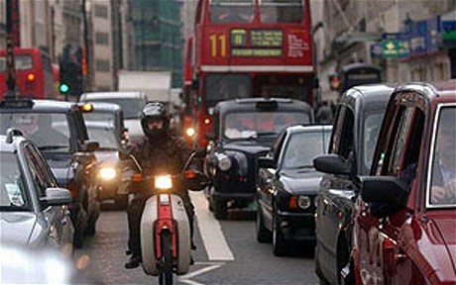
Increase in TRICS Surveys in London
Agreement states that from 2015 there should be at least 30 Greater London TRICS surveys undertaken
Additional surveys to be linked to membership sign-up to TRICS of London Boroughs
Notes:
The Agreement states that from the 2015 TRICS data collection programme onwards there should be at least 30 surveys undertaken in the capital, a slight increase on the level of TRICS surveys that have been taking place annually over the last few years. On top of this, additional surveys will take place pro-rata to the number of London Boroughs that sign up as TRICS members. Since 1st April 2014, a number of London Boroughs have joined TRICS, so the process is already underway. With these additional surveys being covered by London Borough licence fees everyone will benefit from the new arrangements.

Slide 14
TRICS Surveys in London to be Enhanced
Origin/Destination surveys (some sites)
Servicing Vehicles surveys (some sites)
All future TRICS surveys in London will include the following new modes:
Tram Passenger
Underground Passenger
Overground Passenger
National Rail Passenger
Docklands Light Rail Passenger
Water Service passenger
Notes:
Another part of the Agreement states that future TRICS surveys within Greater London will be enhanced. Where possible, Origin and Destination counts will be undertaken (and will appear in the TRICS database in a similar format to how they appeared within individual sites in TRAVL). Also where possible, a new Servicing Vehicles count will take place, identifying servicing vehicles by vehicle type (car, light goods vehicle, OGV1 and OGV2). For all new surveys in London, there will be a greater split of transport modes introduced. The infrastructure has already been put together for our TRICS data collection forms, and in the coming months the programming work will be taking place so that London-based TRICS data appearing in the database in 2015 will heva this greater breakdown of count types (as are shown in this slide).

Slide 15
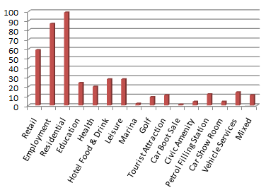
Current TRICS Database in London
413 surveys available in TRICS within Greater London
Represents 5.8% of the database
74 land use sub-categories covered
146 London surveys added since 2008
Notes:
I can finish this presentation by showing you a snapshot of the current TRICS database in London. TRICS has been committed to data collection in London for many years (with Greater London being one of the 17 regions in the database), and there are currently 413 surveys available, representing 5.8% of the entire database. Covering 74 land use sub-categories, 146 London-based surveys have been added to TRICS since 2008. This new Agreement with TfL will enhance our London-wide database significantly on an annual basis.

