Slide 1
TRICS System Developments & Good Practice in 2014
Ian Coles, TRICS Project Manager, JMP Consultants Limited

Slide 2
System Developments
TRICS Version 7.1.1 released in Dec 2013
TRICS 7 Launch Event (London, Jan 2014)
TRICS 7.1.2 – July 2014
TRICS 7.1.3 – September 2014
2014 TRICS Good Practice Guide
Notes:
In this presentation I am going to provide a brief preview of forthcoming TRICS system enhancements that are currently being developed. As most of you will probably know, the first version of the TRICS 7 series was launched in December 2013, and this was followed by a successful Launch Event in London in January. What I am going to do is take you through the system developments that are to be introduced for the imminent 7.1.2 version in July 2014, followed by those in the 7.1.3 version in September. AT the end I will also (briefly) mention the 2014 TRICS Good Practice Guide, which is in the process of being written.

Slide 3
TRICS 7.1.2 – July 2014
Note on saving and retrieving work
Re-naming of residential land use categories
Amended definitions for certain land use sub-categories
“Parking Capacity” percentage figures
Summary of 85th/15th percentile trip rates
Show on-site parking spaces in site lists
Split public transport types in mode split pie charts
Notes:
As you can see, there are quite a few new features being introduced for the imminent 7.1.2 release this July. I will go through each of these, but here are the headlines.

Slide 4
TRICS 7.1.2 – July 2014
Add day of week to Selected Days line graph
Quick access to sites from Selected Days line graph
“Spaces” TRP changed to “Parking”
“Estimate” value to be kept when switching modes
Notes:
These changes have been brought about by the results of our annual User Survey (the 2014 version of which will be sent out to all users this Summer), and from the much valued feedback we received at the January 2014 TRICS 7 Launch Event in London.

Slide 5
Note on saving and retrieving work
Not possible to retrieve saved work across different TRICS versions.
Users can download off-line versions and keep saved work indefinitely.
New note will explain this.
Notes:
So, on to the new features for TRICS version 7.1.2. This version of the system is being released in the middle of July. The first feature is the provision of a note (accessible by a new button) that explains the situation with regards to saving and retrieving work. Because of the dynamic nature of TRICS system development, with changes and tweaks happening with every new system update, it is not possible to retrieve saved work files across different release versions. However, one way around this is for users to download the off-line versions of the system, which can then be kept indefinitely, and therefore saved files able to be retrieved for as long as the corresponding off-line version is downloaded and available for use. As some users may not be fully aware of this, the new note will provide clarity.

Slide 6
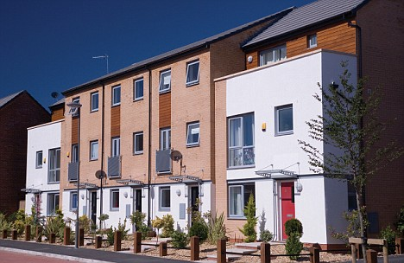
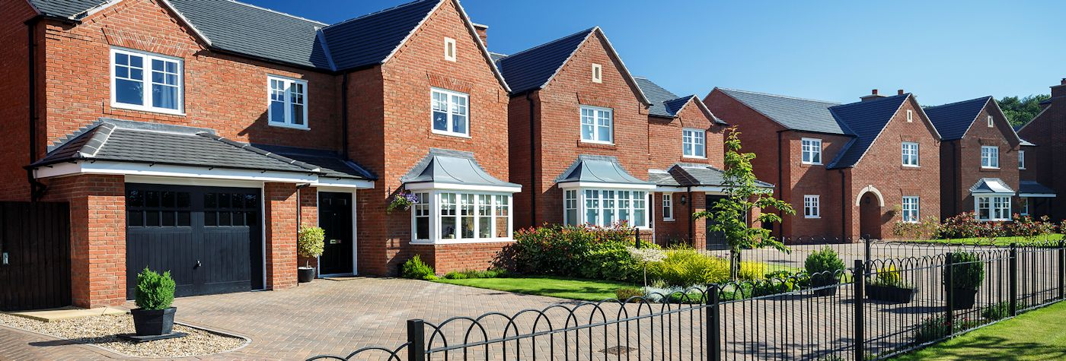
Re-naming of Residential land use categories
03/A: Houses Privately Owned
03/B: Affordable/Local Authority Houses
03/C: Flats Privately Owned
03/D: Affordable/Local Authority Flats
03/K: Mixed Private Housing (Houses & Flats)
03/L: Mixed Affordable Housing (Houses & Flats)
03/M: Mixed Private/Affordable Housing
Notes:
We have also looked at the naming of the Residential land use sub-categories within the database, as in the past these have been confusing to some users. Therefore, as you will see from this list, we have renamed a number of the sub-categories accordingly. This will hopefully also provide good clarity to users.

Slide 7
Amended definitions for certain land use sub-categories
Amended definitions for the following sub-categories:
Nursing Home
Care Home
Pub/Restaurant
Public House (without restaurant)
Notes:
There are two areas where we could do with amended land use sub-category definitions. The first is the difference between “Nursing Homes” and “Care Homes”. There is of course some cross-over between the two sub-categories, but we will be reviewing the definitions so that the two can be more clearly distinguished. The same applies to the “Pub/Restaurant” and “Public House (without restaurant)” sub-categories. These days, most pubs and bars have significant food elements, whereas in the past this would not have been the case. Again, we have seen some cross-over here, so we will be updating the definitions accordingly.

Slide 8
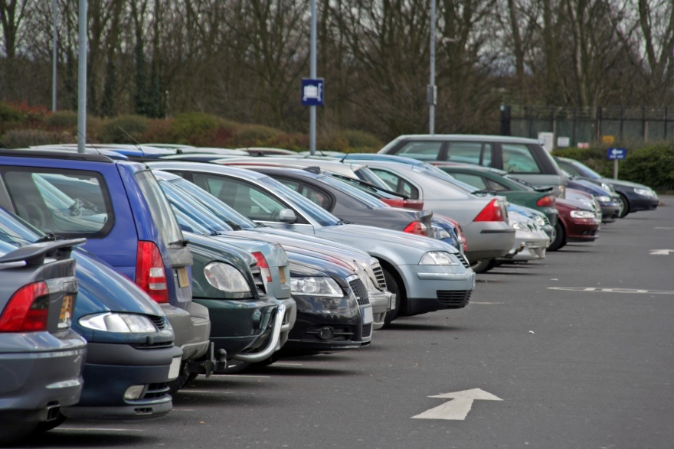
“Parking Capacity” percentage figures
“Parking Capacity” based on on-site parking spaces and parking accumulation
Shown as a percentage figure that displays the maximum car park occupancy level during a survey.
Notes:
To provide users with information on how busy a site’s car park is during a survey, we are to introduce a “parking capacity” percentage figure which is based on the number of on-site parking spaces and the parking accumulation throughout the survey period. This shall only apply to sites that have their own parking facilities. For an individual count, the system will take the total number of on-site spaces, look at the maximum parking accumulation, and then produce a percentage figure displaying the level of occupancy on the day. As off-site parking is also included in TRICS surveys, an explanatory note shall make this clear to avoid any confusion. This development could open up further analysis opportunities in the future.

Slide 9
Summary of 85th/15th percentile trip rates
Site reference codes and actual trip rates of 8th and 15th percentile sites in rank order lists to be displayed.
Notes:
We are also going to enhance the indication of 85th and 15th percentile trip rates in rank order lists. At the moment we currently display the numbers of the surveys in the list that represent the 85th and 15th percentile positions. We are going to add next to these numbers both the site reference codes and the actual trip rates taken from the rank order list, giving users a quick and handy reference.

Slide 10
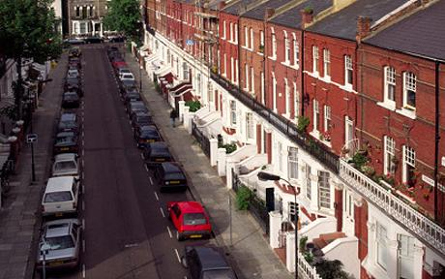
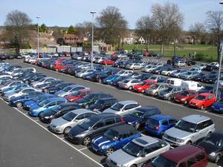
Show on-site parking spaces in site lists
Number of on-site parking spaces to be displayed in site lists for all land use types where parking information is available.
Easy reference for users (for example when analysing lists of residential sites).
Not to be confused with trip rate calculation parameters.
Notes:
In the new update, the number of on-site parking spaces will be displayed in all site lists where such parking information is available. This will provide an easy reference for users (for example when analysing lists of residential sites to get an idea of parking spaces per dwelling). However, this should not be confused with the availability of parking spaces for calculating trip rates. This calculation option will remain active for restricted land use sub-categories.

Slide 11
Split public transport types in mode split pie charts
Current pie chart shows “Public Transport User” percentage.
Further split to differentiate between “Bus Passengers”, “Train Passengers” and “Coach Passengers”.
Potential for further pie chart splits later on.
Notes:
The current modal split pie chart shows “public transport user” as one of the pie slices, along with vehicle occupants etc. We are introducing a more detailed split for the new update, that will break down the percentages further into “train passengers”, “bus passengers” and “coach passengers” (where this split of data is available). This is a similar enhancement to when we originally split the “vehicle occupants” percentage between “single vehicle occupants” and “multi vehicle occupants”. An explanatory note will accompany this upgraded pie chart.

Slide 12
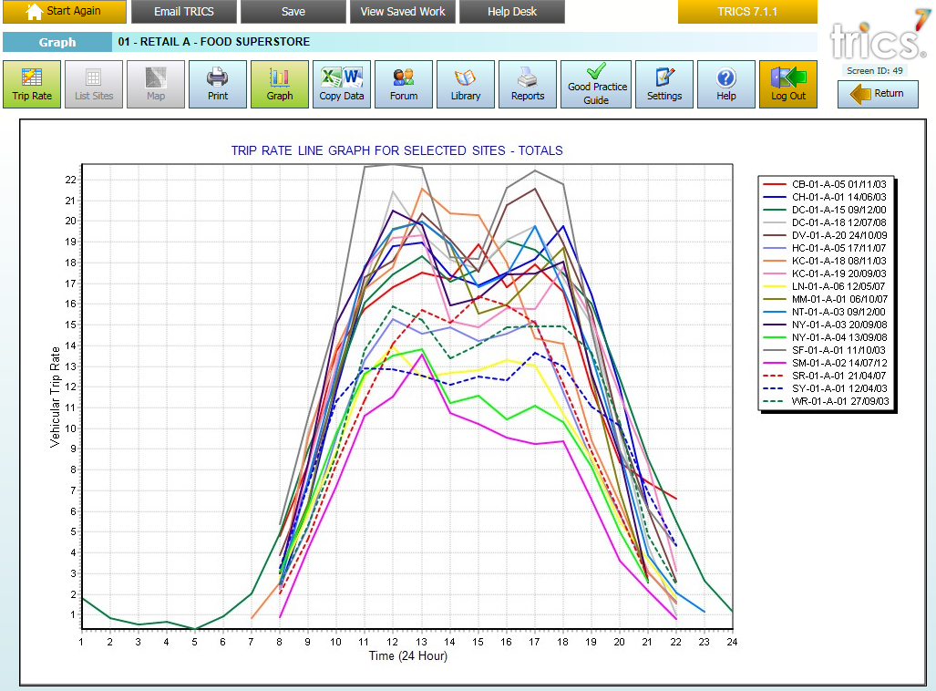
Add “Day of Week” to Selected Days line graph
Notes:
Here you can see an example of a Selected Days line graph for a selection of food superstore sites. We are making a couple of enhancements to this new feature. Firstly, we are going to add the day of the week to the key that is shown on the right of this image.

Slide 13
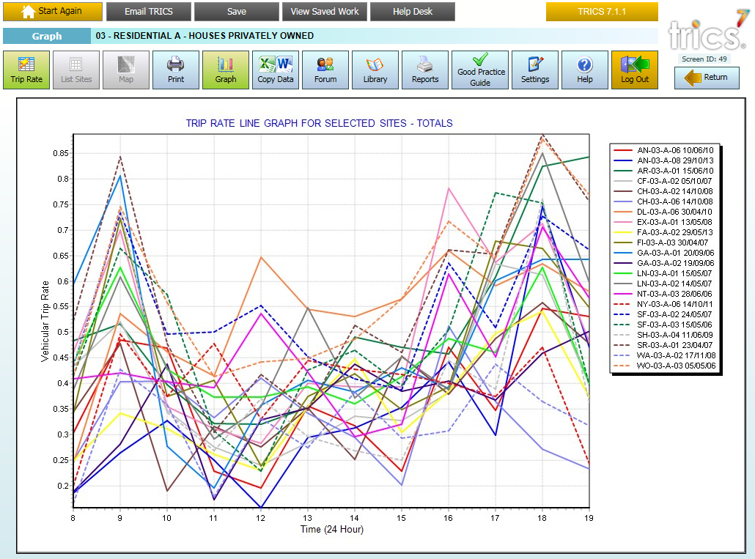
Quick access to sites from Selected Days line graph
Notes:
Here is a second example of the Selected Days line graph, this time for the “houses privately owned” land use sub-category. The second enhancement we are introducing to this feature is the availability to click on a site within the key shown on the right of the screen, which will then take you into the database site record for the selected survey. This will be a quick and handy way for users to identify sites in the graph and quickly look them up, so no need to note the site reference down and then go into the site manually, speeding things up considerably.

Slide 14
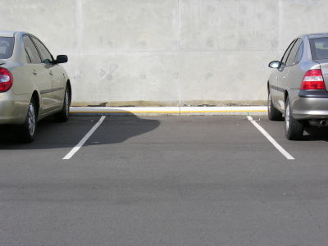
“Spaces” Trip Rate Parameter changed to “Parking”
To provide users with clarity, the trip rate calculation parameter for on-site parking spaces is to be renamed “Parking”.
Notes:
One suggestion that came from our TRICS 7 Launch Event in London was to clarify the on-site parking trip rate calculation parameter name, as there was some confusion with some users. So that is what we are doing. In TRICS 7.1.2, what was called “Spaces” will now be called “Parking”.

Slide 15
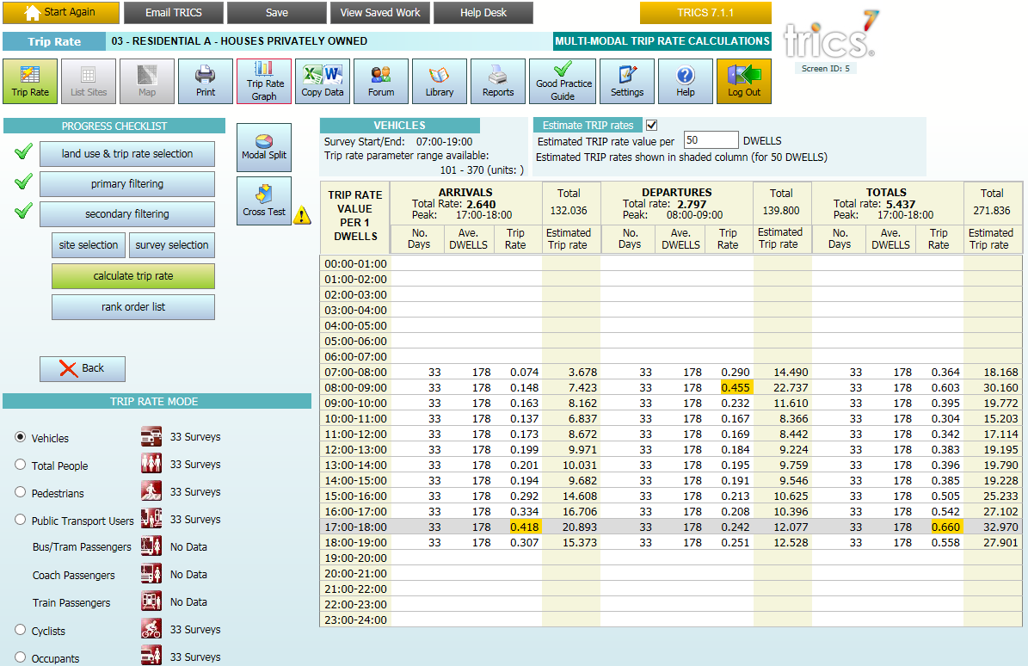
“Estimate” value to be kept when switching modes
When using the “Estimate” feature in the trip rate results screen, the estimate value will no longer be reset when users switch between modes.
Notes:
Here is something else that was pointed out by users when we had our TRICS 7 Launch Event. If they used the “estimate” feature in the trip rate calculation results screen, when switching between modes the estimate value would be reset. We have listened to users, and in this new update you will be able to switch between modes whilst keeping the same estimate value in place, allowing for much quicker trip rate comparisons.

Slide 16
TRICS 7.1.3 – Sept 2014
New land use sub-categories
Link to car ownership rates on the internet
New “Town House” dwelling type
Introduction of “Peak Hour” analysis bar chart
“Parking per Dwelling” shown in Residential rank order lists
Notes:
Now we can move on to the system developments that will be introduced for the subsequent update of TRICS, version 7.1.3, which is due to go live in September 2014.

Slide 17
TRICS 7.1.3 – Sept 2014
Introduce new survey count types (applies to Greater London surveys)
Expansion of mode types
Servicing Vehicles count
Origins/Destinations count
Notes:
As you can see here, there are some more significant enhancements, especially as a result of the recent agreement between TRICS and Transport for London, which we can briefly go through.

Slide 18
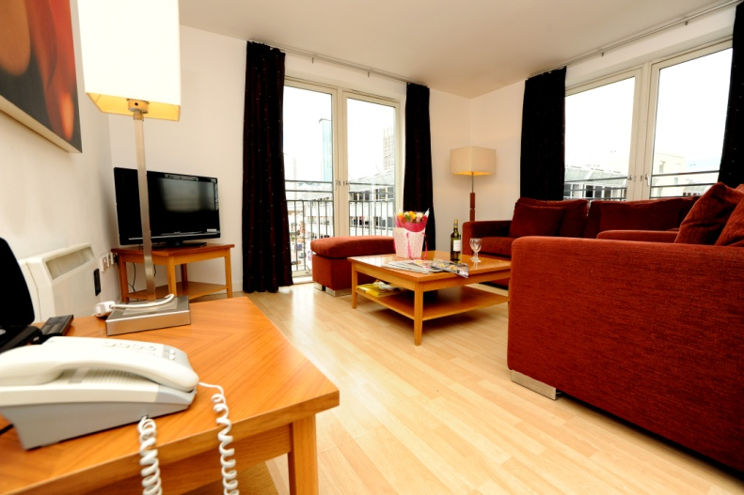
New land use sub-categories
There will be two new land use sub-categories introduced for the 2015 data collection programme:
Financial Services
Serviced Apartments
Notes:
Firstly, there will be two new land use sub-categories added to the database for the 2015 data collection programme. These are “financial services” (effectively high street banks and other similar institutions), and “serviced apartments” (blocks of serviced apartments that can be booked in the same way as hotel rooms or for longer periods). Recent years have seen an increase in such accommodation, so it is considered the right time to bring this new category into the database. Surveys at financial service sites have been requested by users over the last couple of years, so this addition also reflects that.

Slide 19
Link to car ownership rates on the internet
Investigating websites that can provide car ownership figures by postcode.
Link will be provided from individual TRICS site records.
Caveat required as data will not be at the time of surveys.
Notes:
We are investigating websites that can provide car ownership figures for a given postcode, and we are looking to introduce a link from the Site Details screens of individual TRICS site records to this. At the moment we show a car ownership range per household, but we are looking for more detailed information to assist users further. We will be adding a caveat to say that the information on the web is not at the time of the actual survey at the individual site, of course.

Slide 20
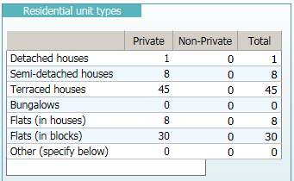
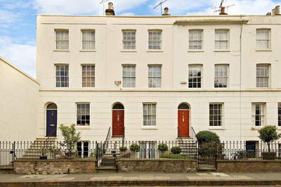
New “Town House” dwelling type
Town houses will be added as a new dwelling type, as part of the overall split that includes detached, semi-detached, bungalows, etc.
Notes:
We shall be adding a new dwelling type for sites in our Residential land use sub-categories, called “Town Houses”. As you can see from the top image, we currently split dwellings by semi-detached houses, detached houses, flats, bungalows, etc. The new town houses category will fit into the mix, and we shall review the database retrospectively, making amendments to the data where necessary.

Slide 21
Introduction of “peak hour analysis” bar chart
On the trip rate results screen there will be a “peak hour analysis button”.
Users will see a bar chart showing peak activity times across the sites in the selected dataset.
Notes:
As a new graphic option, we are to introduce a “peak hour analysis” bar chart once a trip rate calculation has been undertaken. On the trip rate calculation results screen we currently show options for trip rate graphs. We shall add a new button called “peak hour analysis”, that will display a bar chart for the hours of the day and the frequency of the peak hour occurring in each time period across the sites in the selected dataset. For example, say we had 15 selected sites, and 6 of these had their busiest hour during 1100-1200. The bar chart for 1100-1200 would be six blocks high, and so on. Users will have the option to produce a peak hour graph by arrivals, departures or totals. This will be a handy new analysis feature that users could print out or save as a JPEG in the usual way.

Slide 22
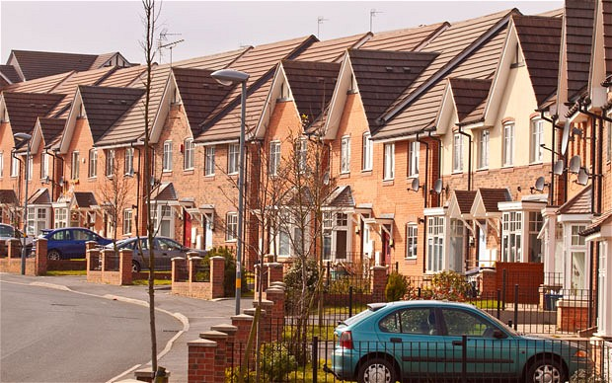
“Parking per Dwelling” in Residential rank order lists
In rank order lists for Residential sub-categories, a new column showing the number of on-site parking spaces per dwelling will be displayed.
Notes:
Some users have recently expressed an interest in a quick way of referencing the number of on-site parking spaces per dwelling at residential developments. So we have decided to introduce a new column within rank order lists for residential datasets that provides this information. When viewing a rank order list, users can export this information to excel, where further calculations and sorting etc can take place.

Slide 23
Expansion of mode types (Greater London)
The following new mode counts are to be collected:
Underground
Overground
Docklands Light Rail (DLR)
Tram (all regions)
Water Service
National Rail
Notes:
As part of the recent agreement between TRICS and Transport for London, it has been agreed that for surveys in Greater London there will be new mode counts introduced. These include Underground, Overground, Docklands Light Rail, Tram, Water Service and National Rail. Note that we are splitting counts (for all new data entering the system) to display the Tram mode separately for all regions, not just London. So for future surveys at sites where tram trips are a possibility there will be separate counts for this mode. It is possible that in the future we may also look at “metro” counts (the equivalent of “Underground”), in cities such as Newcastle etc.

Slide 24
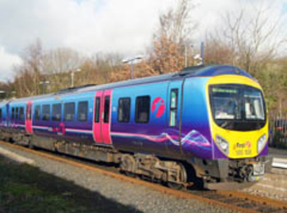
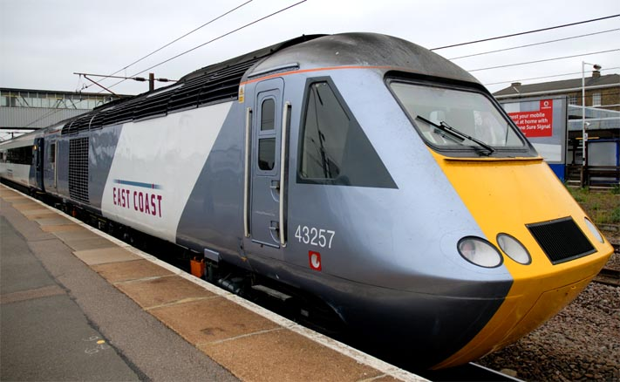
“Total Rail”
The existing “Train Passenger” count will be renamed “Total Rail”. The split between local and national services may be included for other TRICS regions in the future (starts with Greater London).
Notes:
At the moment in the database we have the “Train Passengers” count. This count encompases all types of train journeys, so in London this would include Underground, overground and national rail combined. The same applies to other regions. If there are passengers of national services and passengers of local services then both of these will be combined in the “Train Passengers” count. We are going to rename this count “Total Rail Passengers”. For Greater London, users will start to see sites that have this count split between Underground, Overground and National Rail, and we may also update our methodology for sites outside of London once this new method has been fully established.

Slide 25
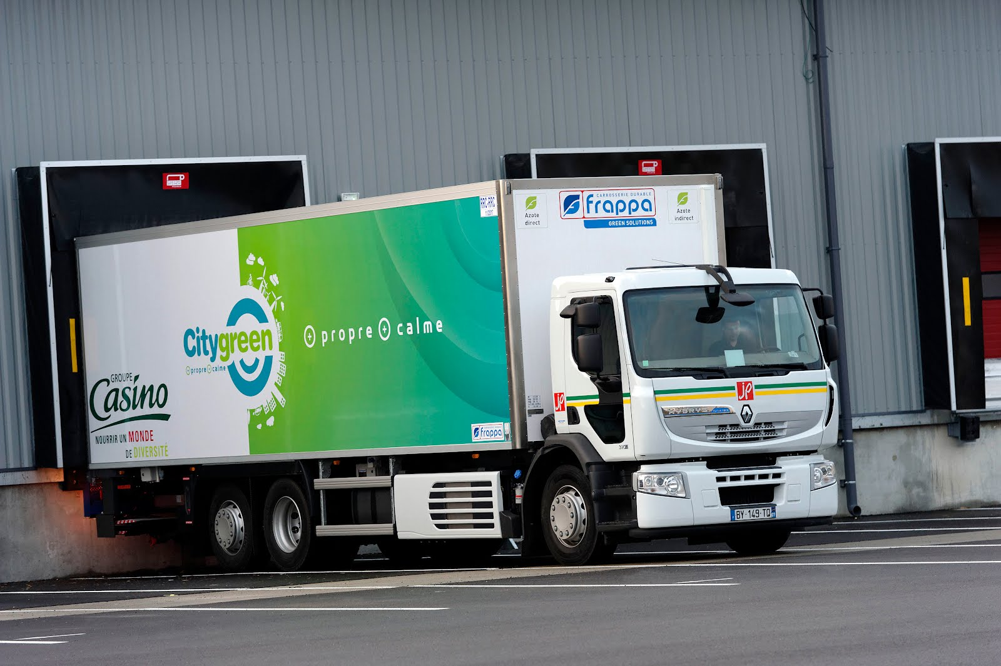
Servicing Vehicles count (Greater London)
Separate count of vehicles servicing individual sites (included in overall vehicles count).
Shown by direction and time period, split between cars, LGV’s, OGV(1) and OGV(2).
Notes:
For some future surveys in Greater London, again as part of the agreement between TRICS and TfL, we shall also be collecting a separate “Servicing Vehicles” count, by time period and direction. This count will of course include vehicles in the Total Vehicles count, but we are going to provide a separate count table that shows the servicing vehicles split by cars, light goods vehicles, OGV(1) and OGV(2). Due to the nature of some sites this count will only be possible in certain situations.

Slide 26
Origins/Destinations Count (Greater London)
For applicable surveys, interviews will ask for origin/destination postcode information.
A simple table of postcodes and frequencies will be included in individual site records.
“Full interview” surveys only.
Notes:
Also for some future Greater London surveys we are going to include origin and destination counts. Again, this is something that was negotiated as part of the TRICS agreement with TfL, and will apply only in situations where such a count is feasible (i.e. full interview surveys). This new count will not be split by mode or time period, it will simply be a table of postcodes and frequencies. It will not be factored up based on a survey sample and a head count, it will just be the result of all interviews where the postcodes were known by respondents. Again, we may be able to look at expanding this to other regions over time, once we have established the new methodology for London surveys.

Slide 27
2014 TRICS Good Practice Guide
To be published this Summer.
Essential document for both users and recipients of TRICS data.
Updated every year.
Your feedback is welcomed.
Notes:
Finally, a quick note about the 2014 TRICS Good Practice Guide. This is a document that is being published soon (this Summer), and we shall let all of our users know when it is available. Updated every year, this is an essential reference for both users of TRICS and recipients of its data outputs. There is a lot of information in this guidance that helps you to understand the flexibility of the system and the correct way to use it. It is not a very large document, but it does contain some very valuable guidance, and it is often used up to Public Inquiry level, so definitely something to become familiar with. We would like your feedback on issues of good practice, and this afternoon’s open forum would be a good place to let us know what you think, before we go ahead and update the guidance for 2014.

