Slide 1
TRICS Travel Planning Module
Nick Rabbets, Dorset County Council
Notes:
This presentation provides an outline of a proposed new Module to be developed by TRICS. Many of you will be aware that in 2012 I presented a paper showing the proposed new TRICS 7 design. This is very much in the same line, I will try and give you an idea of what TRICS are thinking of doing and I would like to hear your views.

Slide 2
Introduction to TRICS Travel Planning Module
Number of Requests Received from Various Parties
Currently at the investigation and evaluation stage
We need YOUR input – This session will be important to us, you can also discuss ideas in this afternoon’s Forum
Notes:
I would like to introduce you to TRICS TPM, which is a project to design a Travel Planning Monitoring Tool which has come about by a number of requests from various people suggesting that TRICS could use its extensive knowledge to create a system that is efficient, adaptable and user friendly. It is envisaged that the system will be completely separate from TRICS, but will build upon our experience in users interfaces, data collection and data display.
We are currently at an early stage in the development of the design, having been recently investigating system framework options, but we can offer you a glimpse at the concept this morning.
During this afternoon’s open forum session everyone will have the chance to give us their ideas and discuss these as a group, but for now I’d like to go through a few mock-up screenshots to give you a first glance at the kind of thing we are looking at introducing. We’ve actually made some minor tweaks already to the example you are about to see, but this gives a good initial view of how we see the layout and design of TRICS evolving.

Slide 3
Key Elements
Easy to Use
Hub for each
Travel Plan
Designed to be used by:
Local Authorities
Consultants
Site TP Coordinators
Schools
Action Groups
Notes:
As with all our systems we are trying to make it as easy to use as possible. We envisage the system to be the hub of Travel Planning for all parties involved, starting at the initial concepts of the Travel Plan and writing of the documents all the way through the monitoring once the Travel Plan is in operation and output of comparison reports.
The system will be a multi level tool, enabling users to view and amend any number of sites they are Authorised to access. So a LA TPO may have access to all the sites within there County; a Company TPO may have access to all the Company Sites within the Country; where a school Head may only have access to their particular school.

Slide 4
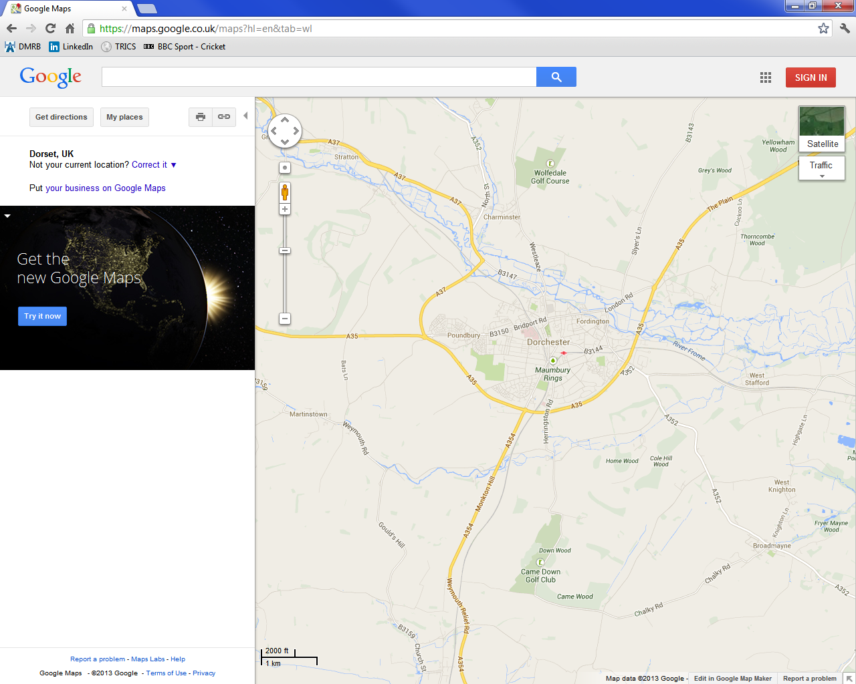
TRICS TPM
LOGO
Version No.
Email TRICS
Help Desk
Tutorial
H Home Page
My Account
Main Menu
TRICS Travel Plan Module
Document
Templates
Good
Practice
Guide
New TP
Forum
Library
Settings
Help
Logout
Available Travel Plans
Actions
Map
Dorchester Tesco
Hardy’s School
Poundbury Phase 1
6
=
6
Click heading to Sort by that Column
LOGGED IN AS
Name: Sam Smith
Organisation: Dorset County Council
User Ref: 12grt342-001
Double click Travel Plan Name or Icon on Map to go to record
Notes:
This screen will be the Home Screen once logged on.
If User has a Non-Admin Licence the “New TP” Icon will be greyed out, they will have to contact the relevant TP Administrator to get them to add their User Ref into the “Travel Plan Settings Screen”
Traffic Light system will warn user of impending actions for each Travel Plan. We will need to consult with Travel Planners and need to think about voluntary travel plans, DMT plans, schools, timescales, outstanding actions. Red Urgent, Orange Imminent, Green OK, think of another for Overdue
Note that the “Help Desk” will be separate from the TRICS Help Desk.
Double Clicking an Icon on the Map or the Travel Plan in the list will take you to the “Main Details Screen” for the relevant TP. Map Auto Zoom to extents.
Clicking “Home Page” button throughout the system will return the user to this page, if they have access to multiple TPs; or the “Main Details” screen for single TP users.
Needs to be a database of user refs and lists of accessible TP’s. Also Database of TP’s with list of Allowed Users

Slide 5
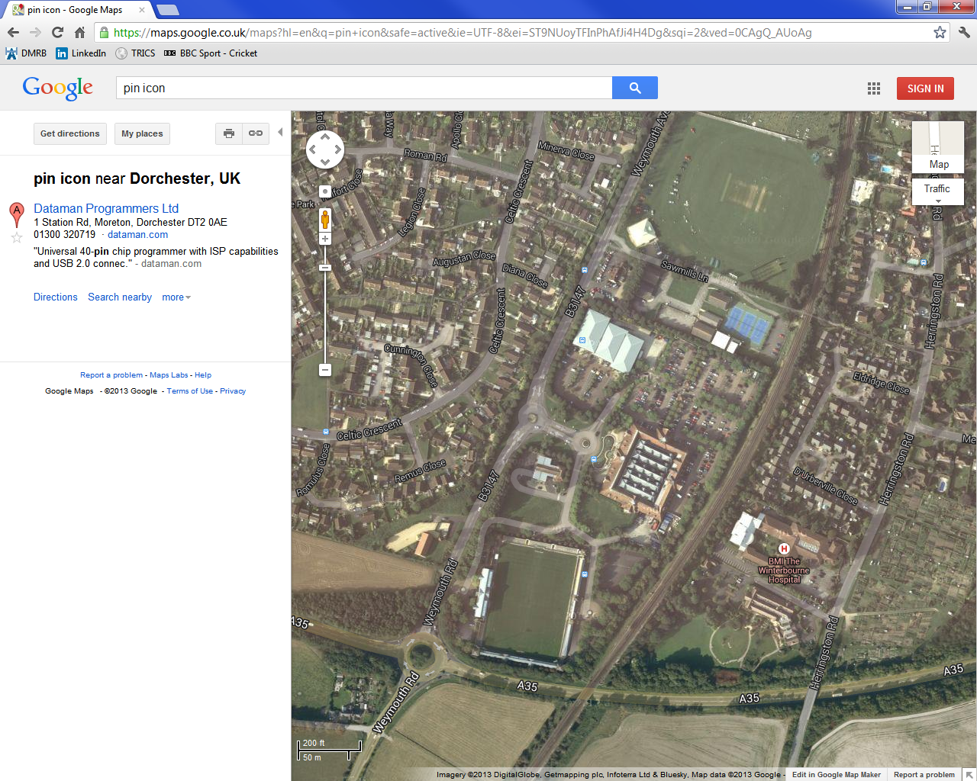
TRICS TPM
LOGO
Version No.
Email TRICS
Help Desk
Tutorial
H Home Page
My Account
Main Details
Dorchester Tesco Travel Plan
TP Code
Document
Templates
Good
Practice
Guide
New TP
Forum
Library
Settings
Help
Logout
Main Details
Reminders
Title
Dorchester Tesco Travel Plan
Calendar
10-10-2013 – Site Meeting - LATPO
22-10-2013 – Questionnaire Survey – STPC
13-11-2013 – Analyse Survey Results – STPC
13-02-2014 – SAM Surveys Required – STPC
01-04-2014 – TP Monitoring Report - LATPO
Location
Dorchester Tesco
Contacts
Street
Castle Way
Site Documents
District
Surveys
Town
Dorchester
Notes
TRICS Area
DC
Travel Plan Targets
Postcode
DT1 1XJ
Transport Assessment Figures
Latitude
54.75100
Longitude
-6.21542
Area of Travel Plan
Planning Application Number
TP Reports
6/2012/1234
Main Details
TP Type
Retail - Employees
Site Changes
6
TP Category
Compulsory
Cycling
6
Car Sharing
TP Status
Active
Travel Plan Measures
6
Financial
Public Transport
Shuttle Bus
Web-Site
Notes:
This will be the opening screen for each individual TP Record
TP Code – Unique number (TP-14001-DC) TP=Travel Plan 14=Year Created 001=Count DC=TRICS Area Code. EVERY DATABASE IN SYSTEM LINKED VIA TP CODE
A reference number should be automatically created for each travel plan. It should be based on the TRICS area code plus a unique number.
“Site Documents” would pull up planning and travel plan documentation.
TP Type: Residential, Employment, Retail-Employees, Retail-All Users, School, Hospital, Mixed
TP Category: Compulsory, Voluntary (definitions to be included via a button here, including S106, conditions etc)
TP Status: Active, Draft, Closed
In the “Reminders” box, the key activities could automatically change colour when they become overdue.
The area of travel plan image could be obtained from application documents.

Slide 6
TRICS TPM
LOGO
Version No.
Email TRICS
Help Desk
Tutorial
H Home Page
My Account
User Settings For
Dorchester Tesco Travel Plan
Document
Templates
Good
Practice
Guide
New TP
Forum
Library
Settings
Help
Logout
Main Details
User Access Restrictions List
Calendar
Name | User Reference | Company | Access | Details | Calendar
S.S.Smith | 15987U12gyw£ | Dorset CC | Administrator
A.R.Jones | 1476554E45sfd& | Tesco | Coordinator
P.Potts | 57319M71nbs$ | Dorchester Town Council | View Only
Contacts
6
Site Documents
=
Surveys
Notes
Travel Plan Targets
=
6
6
6
Transport Assessment Figures
TP Reports
Save Changes
Only an Administrator can change access restrictions.
Main Details
Standard access restrictions can be amended by clicking Radio Buttons in above Table. Filled Button
means full access, empty Button means viewing only.
Site Changes
Cycling
User Ref.
15987U12gyw£
Car Sharing
6
Save User to Access List
Travel Plan Measures
Title
Mr
First Name
Sam
Surname
Smith
Financial
Dorset CC
Public Transport
Company
Delete User Access
Administrator
Shuttle Bus
Access
6
Web-Site
Notes:
Only Administrator has access to this page
This area is populated by the creator of the Travel Plan (the TP Administrator) and restricts the access to relevant users. Some people may only view the system, whilst others may have restricted access so that they can create Calendar entries and emails but not anything else.
Selecting the User Number, populated from the Contacts List, fills in the name and company data; the administrator then selects the standard access restriction category and presses save, this places the information into the above list where personal access restrictions can be amended.
Select User Number and press Delete User Access to remove the access rights, thus not allowing that user to gain access to the information.
A number of Radio buttons can be used to select the type of access allowed by each user, this is undertaken by the Site Administrator.

Slide 7
TRICS TPM
LOGO
Version No.
Email TRICS
Help Desk
Tutorial
H Home Page
My Account
Calendar For
Dorchester Tesco Travel Plan
Document
Templates
Good
Practice
Guide
New TP
Forum
Library
Settings
Help
Logout
Main Details
Create New Event
Update Selected Event
Events Calendar
Double click day to list days events
Calendar
Date
10 October 2013
Time
10:30
Contacts
3 | October |  |  |  |  | 4
Mo | Tu | We | Th | Fr | Sa | Su
30 | 1 | 2 | 3 | 4 | 5 | 6
7 | 8 | 9 | 10 | 11 | 12 | 13
14 | 15 | 16 | 17 | 18 | 19 | 20
21 | 22 | 23 | 24 | 25 | 26 | 27
28 | 29 | 30 | 31 | 1 | 2 | 3
4 | 5 | 6 | 7 | 8 | 9 | 10
Originator
Sam Smith (LATPO)
Site Documents
Event Type
Site Meeting
Surveys
Title/Location
Tesco Dorchester
Notes
Notes
Meeting with Anne Jones to discuss the questions required within Staff Questionnaire and how to encourage car sharing .
Travel Plan Targets
Completed
Event
Selected
Transport Assessment Figures
Notified
Sam Smith (LATPO)
Anne Jones (STPC)
Phil Potts (Dorchester Action…..
Events
Double click event to view
6
TP Reports
6
01-10-2013
09:32 Site Audit Completed
11:00 Postcode Data Sarah Smyth
10-10-2013
10:30 Site Meeting
Tesco Dorchester
22-10-2013
09:30 Post Staff Q.. Anne Jones
Main Details
Reminder
1 Day – Email to Recipients Above
Site Changes
6
Cycling
Car Sharing
Created By
Sam Smith (LATPO)
Save Event
Travel Plan Measures
Financial
Date
13 September 2013
Time
17:25
Public Transport
Completed By
Sam Smith (LATPO)
Event Completed
P
Shuttle Bus
Date
10 October 2013
Time
11:30
Web-Site
Notes:
This area is for the creation of events. Note the “Reminder” bar, this will send an email to selected people to remind them of an event or meeting etc.
If you have admin access you will be able to create an event on this screen. We are thinking of having three levels of access. View Only, Administrator, Full Access (??).
Upon creation of an event, a standard email should automatically be sent to all people in the notification list. In the “Reminder” field the number of days could be changed from 1 to a different number (up to 14 days perhaps?). The “Notified” area should be controlled from the “Contacts” page, with an admin user required to change the entries.
Calendar Database

Slide 8
TRICS TPM
LOGO
Version No.
Email TRICS
Help Desk
Tutorial
H Home Page
My Account
Contacts For
Dorchester Tesco Travel Plan
Document
Templates
Good
Practice
Guide
New TP
Forum
Library
Settings
Help
Logout
Main Details
Active Contact List
Calendar
Name | Job Title | Company | Telephone | Mobile | Email | Date Added
Sam Smith | Local Authority Travel Plan Officer | Dorset CC | 01305 225100 | 07777 225000 | s.s.smith@dorsetcc.gov.uk | 12/11/2010
Anne Jones | Site Travel Plan Coordinator | Tesco | 01305 789129 | 07777 251459 | anne.jones@tesco.com | 02/04/2012
Phil Potts | Dorchester Town Action Group | Dorchester Town Council | 01305 789923 | 07777 145987 | phil.potts8@googlemail.com | 25/08/2013
6
Contacts
Site Documents
=
Surveys
Notes
Archived Contacts
Travel Plan Targets
Name | Job Title | Company | Telephone | Mobile | Email | Date Archived
Harry Bow | Site Travel Plan Coordinator | Tesco | 01305 789123 | 07777 254682 | h.a.bow@tesco.com | 02/02/2012
Transport Assessment Figures
TP Reports
Main Details
6
Site Changes
Archive Selected Contacts
Email Selected Contacts
(Opens Users Microsoft Outlook)
Cycling
Car Sharing
User Ref
15987U12gyw£
Travel Plan Measures
Find Details from
TRICS TP Username
Financial
Name
Sam Smith
Public Transport
Job Title
Local Authority Travel Plan Officer (LATPO)
Add Contact to Active List
Shuttle Bus
Company
Dorset CC
Web-Site
Notes:
The people contained within this area become available for Calendar Events, Reminders and Emails etc. This page would be created by someone like the Travel Plan Co-Ordinator for the site.
Selecting a contact or contacts and pressing the email button will open users Outlook, with email addresses already completed. Could also look at the subject title being partially completed with TRICS TP – and the Travel Plan title; i.e. “TRICS TP – Dorchester Tesco Travel Plan”.
Radio buttons should reset when navigating away from page.
Find Details from Username automatically imports personal details held on TRICS System from the username
Include Date of Archiving

Slide 9
TRICS TPM
LOGO
Version No.
Email TRICS
Help Desk
Tutorial
H Home Page
My Account
Documents For
Dorchester Tesco Travel Plan
Document
Templates
Good
Practice
Guide
New TP
Forum
Library
Settings
Help
Logout
Main Details
Document List
Calendar
Document Title | Date | Author | Company
Transport Assessment | 12/10/2011 | A.N.Other | Some Consultancy
Travel Plan | 15/10/2011 | J.O.Bloggs | Some Consultancy
106 Agreement | 25/11/2011 | N/A | District Council
Base Staff Survey | 20/02/2012 | A.Jones | Tesco
Site Audit | 13/05/2012 | S.S.Smith | DCC
Contacts
6
Site Documents
=
Surveys
Notes
Travel Plan Targets
6
Transport Assessment Figures
Click heading to Sort by that Column
Double Click Document to Open
TP Reports
Main Details
Site Changes
Upload Document to STraPIT System
Cycling
Car Sharing
Document Title
Transport Assessment
Travel Plan Measures
Document Date
12/10/2011
Upload Document
Financial
Public Transport
Author
A.N.Other
Only pdf files accepted for Upload
Shuttle Bus
Company
Some Consultancy
Web-Site
Notes:
Upload Document opens a Browser for the user to locate Document to be Uploaded to system.
Consideration to web-links to Planning Application data etc was made. However, this does rely on web-link always being available and unchanged, therefore, would suggest that pdf’s are only used.
Possible tech note upon pdf size and reduction of large files.

Slide 10
TRICS TPM
LOGO
Version No.
Email TRICS
Help Desk
Tutorial
H Home Page
My Account
Surveys For
Dorchester Tesco Travel Plan
Document
Templates
Good
Practice
Guide
New TP
Forum
Library
Settings
Help
Logout
Main Details
Postcode Data
SAM Data
Questionnaire Data
Site Audits
Survey Date
6
Calendar
15 February 2012
Vehicle Distribution Map
Contacts
Mode
Create New Postcode Data
Site Documents
Vehicle
Total People
Pedestrians
PT Users
Bus/Tram Users
Coach Users
Train Users
Cyclists
Occupants
PSV’s
OGV’s
Taxis
Vehicle
Postcode Data
Surveys
Notes
DT1 1XJ 1
DT1 1XN 2
DT1 1ST 1
DT1 2RD 1
DT2 1AW 1
DT2 4ES 2
DT3 6TH 3
6
Travel Plan Targets
=
Transport Assessment Figures
TP Reports
Main Details
6
Site Changes
Cycling
Car Sharing
Travel Plan Measures
Financial
Public Transport
Shuttle Bus
Web-Site
Created By
Anne Jones (STPC)
Date
16 February 2012
Time
13:25
Notes:
Clicking “Create New Postcode Data” will open a standard template that Excel data can be imported into or manual input can be undertaken. Saving will then record data within Site Documents and place summary within Postcode Data Sheet. Similar sheets will also need to be created for the other types of Survey. Questionnaire Data should have a link to Survey Monkey or similar site.
The system must be able to take existing survey data from other systems, like iTrace, and put them into TRICS TPM. Perhaps need to look at exporting existing data into CSV format, which user can then paste into a standard iTrace to TRICS TPM template.
The map would be linked to travel plan type and travel plan category, and could show catchment areas.
SAM Data – List of SAM Surveys with PDF Documents
Button to contact TRICS to organise a SAM Survey opens Outlook with possibly standard text.
Questionnaire Data – Button to Open Questionnaire Template
Input Template for results
List of Questions with Radio buttons – Data/Graphs/Tables/Charts then displayed similar to above.
Site Audits - Button to Open Questionnaire Template
Input Template for results
List of Questions with Radio buttons – Data/Graphs/Tables/Charts then displayed similar to above

Slide 11
TRICS TPM
LOGO
Version No.
Email TRICS
Help Desk
Tutorial
H Home Page
My Account
Personal Notes For
Dorchester Tesco Travel Plan
Document
Templates
Good
Practice
Guide
New TP
Forum
Library
Settings
Help
Logout
Main Details
Notes for Dorset County Council viewing only
Calendar
Note Title | Date | Author | Note
Cycle Stands | 13/05/2012 | S.S.Smith | Some problems with Cycle Stand positions, need to check on-site once contractor has relocated them.
Neighbour Problems | 15/05/2012 | S.S.Smith | Mrs Jones at 5 New Road very angry with Council and the way they allowed the new Tesco. Be aware and try not to antagonise her.
Neighbour Problems | 25/05/2012 | N.O.Brains | Met with Mrs Jones to discuss the Planning Process and explained how traffic noise would have been taken into account when Application was assessed by District Council. Suggested she wait until construction works have been completed before contacting District Council, as much of the current noise is due to construction lorries etc.
Contacts
6
Site Documents
=
Surveys
Notes
Travel Plan Targets
Transport Assessment Figures
TP Reports
Main Details
Site Changes
Cycling
Car Sharing
Travel Plan Measures
Financial
Public Transport
6
Shuttle Bus
Web-Site
Notes:
This is a notes area for each organisation, not to be viewed by other organisations or users
Facility to Add, Edit and Delete

Slide 12
TRICS TPM
LOGO
Version No.
Email TRICS
Help Desk
Tutorial
H Home Page
My Account
Standard Document Templates
Document
Templates
Good
Practice
Guide
New TP
Forum
Library
Settings
Help
Logout
Main Details
Document Filtering
Calendar
ALL
Search
Document Area
6
Contacts
Document Template List
Site Documents
Document Title | Date | Author | Area
Primary School Travel Plan | 12/10/2011 | TRICS | Travel Plan
Employment Travel Plan | 15/10/2011 | TRICS | Travel Plan
Postcode Data Form | 25/11/2011 | TRICS | Survey Form
School Raised Hands Data Form | 20/02/2012 | TRICS | Survey Form
Employment Email Survey Form | 13/05/2012 | TRICS | Survey Form
Simple Survey Results – Postcode | 15/06/2013 | TRICS | Report
Simple Survey Results – Employment | 28/07/2013 | TRICS | Report
Comparison Report – Employment | 07/08/2013 | TRICS | Report
Secondary School Student Questionnaire | 15/09/2013 | Devon CC | Survey Form
Surveys
6
Notes
=
Travel Plan Targets
Transport Assessment Figures
TP Reports
Main Details
Site Changes
Cycling
Car Sharing
Travel Plan Measures
Financial
6
Public Transport
Double Click Document to Open.
To suggests amendments or additional Standard Documents please use the “Email TRICS” Icon above and
they will be considered and placed within the global library.
Shuttle Bus
Web-Site
Notes:
This is a list of standard documents controlled centrally by TRICS, to consist of survey input templates, reports, travel plans, questionnaire survey questions etc. Once opened these can be changed/personalised, however, only way to add to this list is via TRICS management control. JMP could produce some standard document templates for consultation, along with some accompanying guidelines on the information that is to be provided.

Slide 13
What Next?
Technical Working Group formed to look into details of System
Extensive research into possible Programming Languages
Users Invited to take part in
detailed Alpha Testing
Notes:
A Technical Working Group will be created to involved a number of Travel Planners from Consultancies, Local Authorities and other Organisations to ensure the system is what is actually needed.
As with the TRICS7 design programme we are intending to invite users to get involved in the development and testing of the system. With their comments being recorded via SurveyMonkey, this method was very successful during previous consultations, so we are not intending to change it.

Slide 14
TRICS Community
TRICS Travel Planning progress updates on Twitter and LinkedIn.
TRICS Newsletter coverage at key stages of development
Ideas Always welcomed via Email
Notes:
As always with things we do at TRICS, you the Users are very important. Our systems are designed to make your lives easier, therefore, the more you get involved the better the system will be. Even if you are not involved in the Travel Planning field, suggest to your colleagues that could get involved.

Slide 15
The BIG Question
Should TRICS continue development of the Travel Planning Module?
Notes:
So What do you think?

