Slide 1
Pass-by, Diverted and Transferred Trips: What don’t we know?
Richard Sweet, Principal Engineer, Parsons Brinckerhoff

Slide 2
Introduction
What don’t we know?
In the next 20 minutes…
The new TRICS study – why now?
What are all these types of trip?
Why does this even matter?
What factors could be important?
Discussion (later!)

Slide 3
Why revisit?
Why research this?
Top of the TRICS User Survey wish-list for several years!
Previous research ~20 years old and limited to supermarkets
Can make a big difference to the traffic impact assessed in a TA – comes up frequently when writing (or checking)

Slide 4
What might we want to know?
Comments from TRICS Users on LinkedIn
“Some research on… mixed use developments would, I suspect, be very useful to most practitioners”
“The impacts of an adjacent or indeed internal to the store fast food outlet…”
“It is the small convenience stores such as Tesco Express / Sainsbury Local which seem to be the biggest area of contention at the moment”
“Some research on… fast food outlets would also be very helpful”

Slide 5
Moving on…
A brief explanation
Now…
The new TRICS study – why now?
What are all these types of trip?
Why does this even matter?
What factors could be important?
Discussion (later!)

Slide 6
A map
Types of Trip
My current Supermarket (SainsCos)
My house
My normal route
Another, longer route
My office
Notes:
Context map for types of trip

Slide 7
A primary trip
Types of Trip
My current Supermarket (SainsCos)
My house
Notes:
Primary trips are direct between home (or other origin) and trip (supermarket in this case).

Slide 8
A secondary trip
Types of Trip
My current Supermarket (SainsCos)
My house
My office
Notes:
Secondary trips are just a part of a primary trip (in this case the commute home)

Slide 9
Here comes the competition…
Types of Trip
My current Supermarket (SainsCo)
My house
A New Supermarket (Wait-Op)
My office
Notes:
A new store is added to the network

Slide 10
New primary trips
Types of Trip
My current Supermarket (SainsCo)
My house
A New Supermarket (Wait-Op)
These are completely new traffic movements – but how many of them?
My office
Notes:
Some trips will be entirely new, and affect the whole network – but probably a small proportion.

Slide 11
Transferred Trip
Types of Trip
My current Supermarket (SainsCo)
My house
A New Supermarket (Wait-Op)
Not a new trip, but new movement on the local network as I change my shopping habits
My office
Notes:
Transferred trips originally went to another destination, and now come here – affect the local network only

Slide 12
Pass-by Trip
Types of Trip
My house
A New Supermarket (Wait-Op)
I’m on the network anyway…
My office
Notes:
Background – Types of Trip

Slide 13
Pass-by Trip
Types of Trip
My house
A New Supermarket (Wait-Op)
I’m on the network anyway…
…and decide to stop by.
Result is just an extra movement at site access
My office
Notes:
Passby trips only affect the immediate vicinity – possibly only the site access, which they will pass through twice.

Slide 14
Diverted Trip
Types of Trip
My house
This new supermarket is slightly off my normal route…
A New Supermarket (Wait-Op)
My office
Notes:
Diverted trips affect a slightly larger area than a passby trip

Slide 15
Diverted Trip
Types of Trip
My house
This new supermarket is slightly off my normal route…
… but I can conveniently ‘divert’ to it.
This results in new trips at the site access and on the nearby network.
A New Supermarket (Wait-Op)
My office

Slide 16
How many of each type?
Previous research
Literature review discussion to follow this presentation…
…but suggestion has always been that on a commuting route the vast majority of peak hour trips will not be new.
Notes:
Lawrence to present on literature review.

Slide 17
Moving on…
Who cares?
We’re making progress…
The new TRICS study – why now?
What are all these types of trip?
Why does this even matter?
What factors could be important?
Discussion (later!)

Slide 18
Why does it matter? (1)
Estimated trip generation of a large supermarket
Recent large supermarket proposed for a Somerset town
~8,500 sqm GFA food store (no PFS)
Agreed Friday PM Trips:
448 arrivals
465 departures
Distribution (based on literature):
Pass-by/diverted 15%
Transferred 70%
Result: beyond nearby junctions the impact becomes very small. Is this correct?! What if more are new? Several hundred more movements on the network?
Notes:
Comments on LinkedIn

Slide 19
Why does it matter? (2)
When is a pass-by trip not a pass-by trip?
A recent example…
Industrial Estate
New store
Main commuting route

Slide 20
Why does it matter? (2)
When is a pass-by trip not a pass-by trip?
TA argues that
Pass-by Trips are from the side road
Diverted Trips are from the commuting route
Industrial Estate
New store
Main commuting route

Slide 21
Why does it matter? (2)
When is a pass-by trip not a pass-by trip?
My view was:
This is misinterpretation of the research
Sense check: implied that ~30% of traffic on main road stopped in the supermarket!
Potential result:
Underestimates the impact in the nearby area
Industrial Estate
New store
Main commuting route

Slide 22
Why does it matter? (2)
When is a pass-by trip not a pass-by trip?
This issue is recognised: TRICS 95-2 says:
“The distinction between diverted and pass-by trips can sometimes be difficult to make… as it is not [always] clear what constitutes significant or insignificant diversion… In general it is probably more robust to combine the two values into a single term: non-primary”
And MacIver (1999) ensures definition of the pass-by point:
“where vehicles would turn off the major through route”
[my emphasis]
As with so much research, the ‘key’ statistics are often quoted out of context making them meaningless.
Notes:
Comments on LinkedIn

Slide 23
Moving on…
What don’t we know?
Last part coming up…
The new TRICS study – why now?
What are all these types of trip?
Why does this even matter?
What factors could be important?
Discussion (later!)

Slide 24
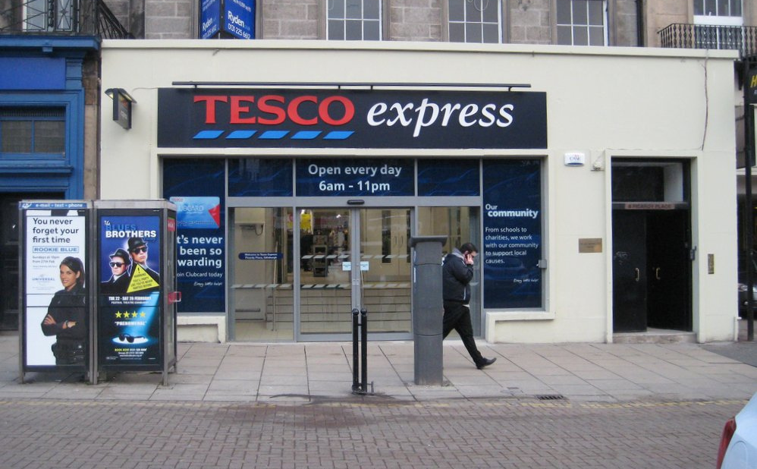
Size of store
Presumably smaller stores have a higher % of pass-by trips?

Slide 25
Time of day
Higher % secondary trips during peak commuting periods?

Slide 26
Customer Behaviour
Fewer trips transferred to a new store – more new ones?
"People are shopping around to get the best value, with many shopping in several different places – perhaps getting their fruit and vegetables in one store and their other groceries elsewhere."
1 March 2013
Notes:
Examples: new Waitrose – will people still go to ASDA? Do people go to Lidl as well as Sainsburys, rather than instead of?
In short, are people really just making more trips rather than transferring?

Slide 27
Car parking – does restraint differ?
Are pass-by trips restrained more by parking than new trips?
Notes:
Will people who passby not bother stopping if they see that the car park is full/people are queuing?

Slide 28
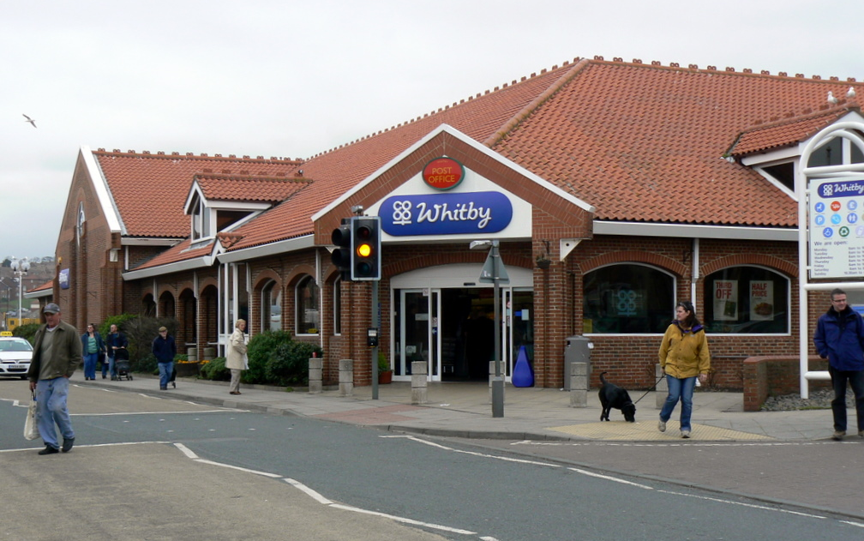
Location, location, location…
Location – commuting routes vs town centre/retail park
Notes:
Logically you would expect more passby trips on commuter routes, at least during peak hours. Is there evidence?

Slide 29
Petrol Filling Station
More transferred trips if local stores don’t have one? More Pass-by trips?
Notes:
Does the presence of a PFS mean more transferred trips? More passby trips?

Slide 30
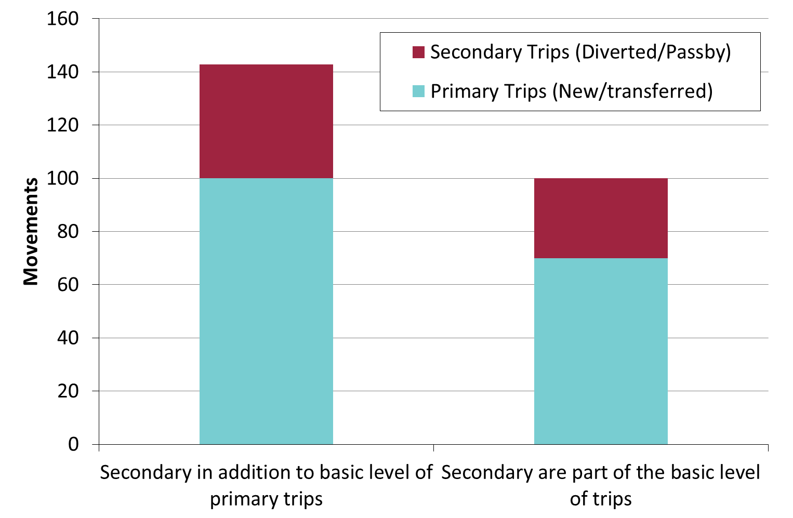
Secondary Trips – inherent, or extra?
Are secondary trips part of the basic trip generation, or an addition?
Notes:
Are passby/diverted trips a proportion of the same total trips, or extra trips on top? i.e. do supermarkets on arterial routes have a higher peak hour generation – not normally accounted for. Could we have a more complex trip generation model than simply floor area or parking spaces?

Slide 31
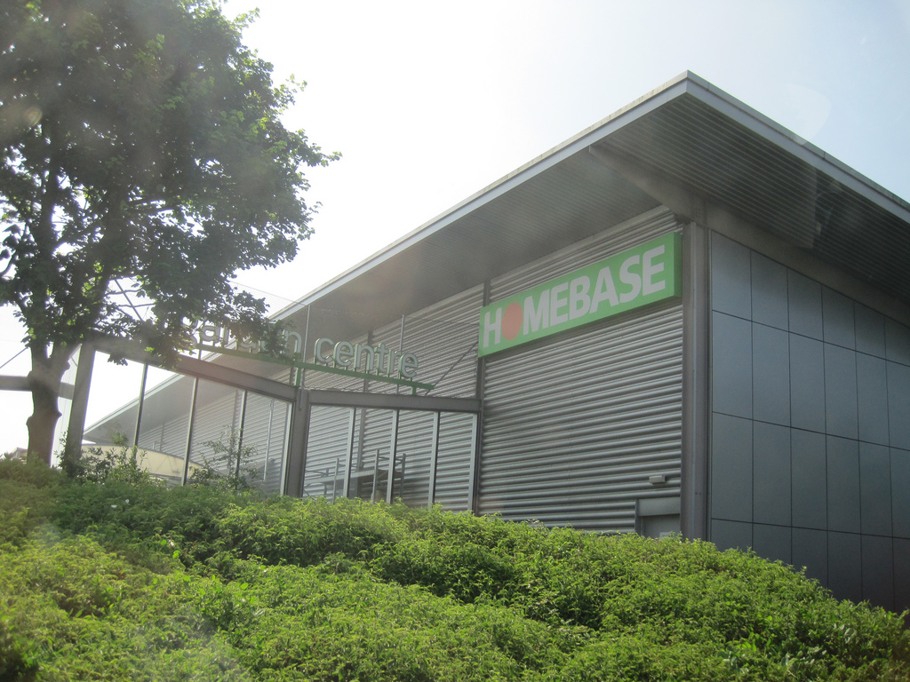
Other types of development
Is it wrong to focus so much on food retail?

Slide 32
What are the knock-on effects?
How might the nature of these trips affect Travel Plan Targets?
Notes:
If a high proportion of trips are pass-by, people may not change their behaviour just because of the supermarket’s facilities.

Slide 33
Conclusion
Lots to do…
Primary vs secondary trips seen as important by many practitioners – good to research it
Significant implications for forecasting developments’ traffic impact if we don’t understand it properly
Existing research limited and often misinterpreted
Numerous potential factors and implications – have we even identified the important ones?

Slide 34
Thank you
Discussion to follow!
Comments/suggestions: Richard.Sweet@pbworld.com
(and copy to Ian!)
Images under Creative Commons Licenses
Elliott Brown - John Walker - Edinburgh Greens - Matt Jones - Carol – Florrie Bassingbourn

