Slide 1
Trip Generation Case Studies Residential & Employment
Notes:
This presentation will go through two hypothetical trip rates calculations looking at the good practice of using each filtering process.

Slide 2
Residential Category Choice
Seven standard residential category choices
Private to Affordable Ratio
Houses to Flats Ratio
Notes:
It is important to select the correct residential land use category. The way to decide which to use is to look at the two ratios.
For example, if the percentage of private dwellings is above 75% and the percentage of dwellings which are houses is above 75% then 03/A Houses Privately Owned should be selected. If either of those figures are below 75% 03/A Houses Privately Owned should not be used and one of the other six standard residential categories should be chosen.

Slide 3
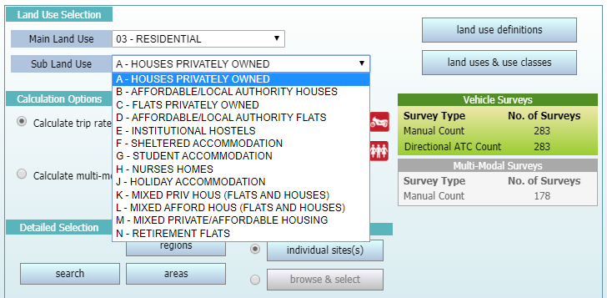
Current Residential Categories
Notes:
The seven standard residential categories are 03/A Houses Privately Owned, 03/B Affordable/Local Authority Houses, 03/C Flats Privately Owned, 03/D Affordable/Local Authority Flats, 03/K Mixed Private Housing, 03/L Mixed Affordable Housing and 03/M Mixed Private/Affordable Housing.

Slide 4
Mixed Private/Affordable Housing
Investigate sites under sub land uses further
Do not assume all sites will be similar
Possible sub land use splits
Notes:
Just because sites are included in the same Land Use category does not mean they are automatically compatible with each other. Some land uses incorporate sites which can vary quite drastically.

Slide 5
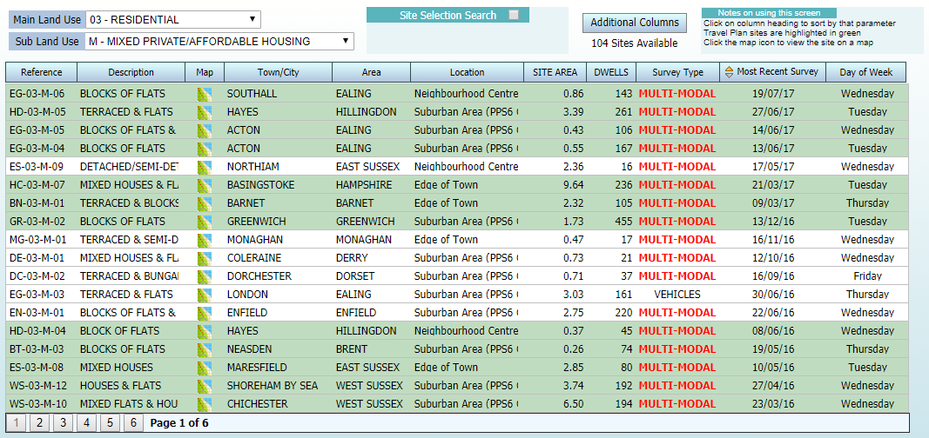
03/M Category Variation
Notes:
For example, 03/M Mixed Private/Affordable Housing can include many different types of housing. EG-03-M-06 is purely flats, HD-03-M-05 is a mix of houses and flats and ES-03-M-09 is purely housing.

Slide 6
Site Selection
Important considerations to make
More to selection than postcode
Take time to investigate
Notes:
Once the appropriate land use has been selected, it is important to decide upon some initial criteria to use in the filtering process.

Slide 7
Region Selection
Research shows not to use regional deselection
Some areas expected to be compatible were not
Some areas expected to be incompatible were
Notes:
It is important not to just look at the postcode of the site and where it is located in the country. Local environmental factors are much more important to consider.

Slide 8
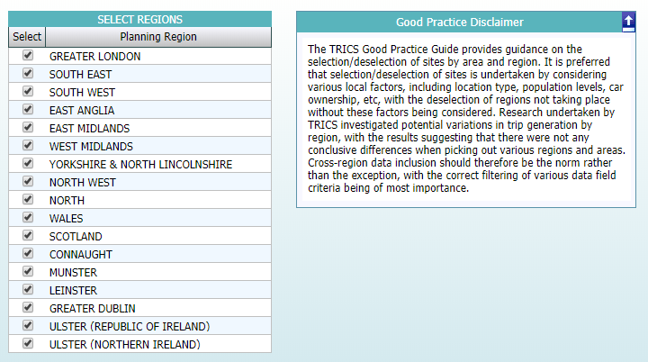
TRICS Regions
Notes:
There are 17 TRICS regions in the UK and Ireland and the regions most often deselected are Greater London, Wales, Scotland, Connaught, Munster, Leinster, Greater Dublin, Ulster Ireland and Ulster Northern Ireland. Removing these nine regions and leaving just eight English regions eliminates roughly a third of the surveys on the TRICS database immediately with no real reason.

Slide 9
Basic Filtering
Trip Rate Parameter Range
Survey Days
Location Type
Notes:
Basic filtering helps to find surveys within a reasonable trip rate parameter range, for example the number of dwellings or site GFA in m², to separate weekday and weekend surveys and to find sites in the correct location types.

Slide 10
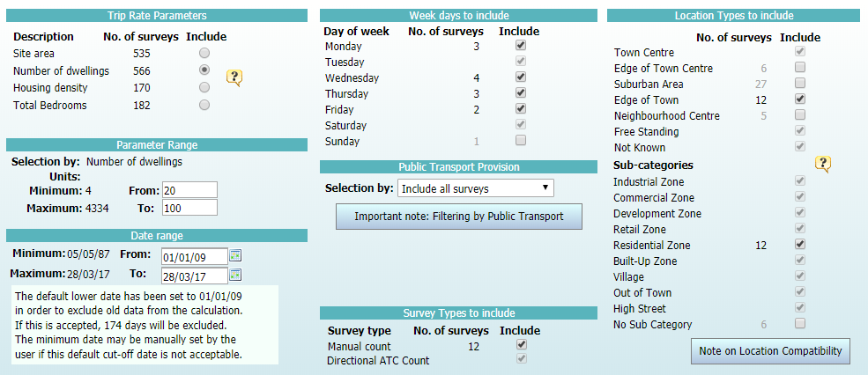
Primary Filtering Page
Notes:
The example used here is for an 03/A residential development with 60 dwellings, in the residential zone of an Edge of Town location. Only weekday surveys are wanted, leaving the above selections.

Slide 11
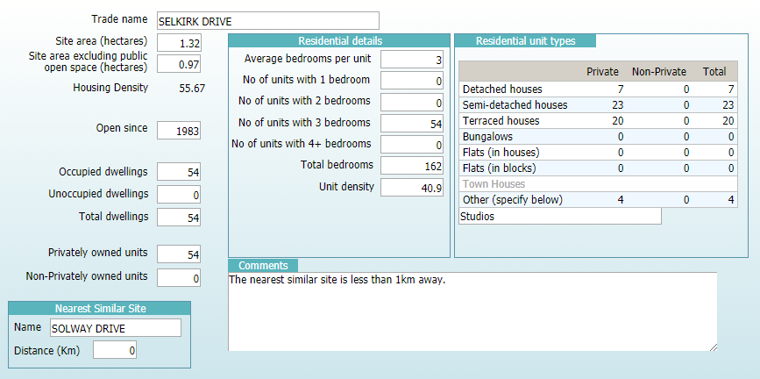
Individual Site Investigation
Notes:
Each individual site should then be investigated to see whether they fit the initial criteria. For example, the above site includes four studio flats so it will be deselected as the hypothetical site is purely houses.

Slide 12
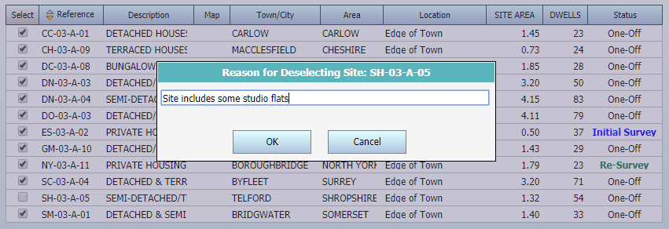
Site Deselection
Notes:
If deselecting a site always give a good reason for its manual deselection to show complete transparency on the decision made.

Slide 13
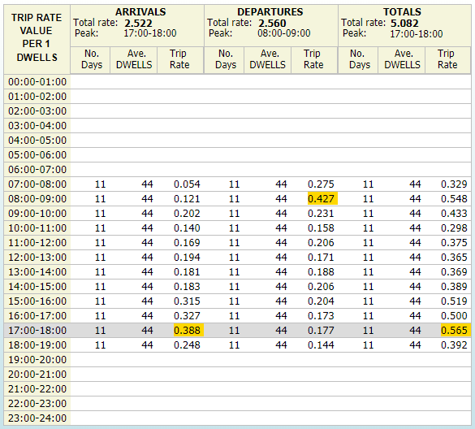
Final Trip Rates
Notes:
The final sample of 11 sites gives the following trip rates calculation per dwelling, with the AM and PM peaks highlighted clearly in yellow.

Slide 14
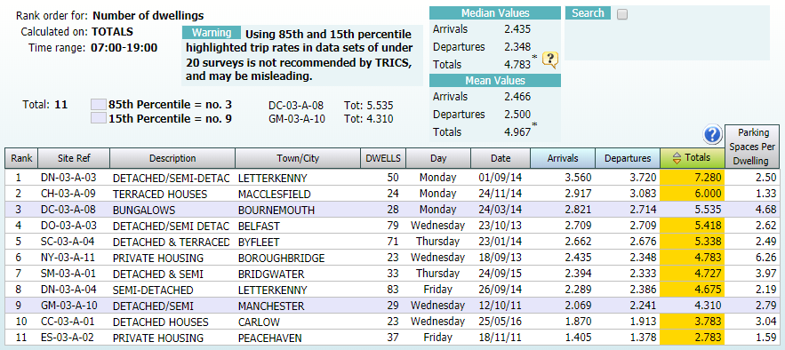
Rank Order List
Notes:
The above rank order list shows the trip rates calculation per dwelling for each site for a time period of 07:00-19:00. It is clear to see we have sites from all regions in this calculation report and they are spread through the ranking. For example, sites from Ireland are 1st, 8th and 10th with sites from southern England in 3rd, 5th and 11th. This suggests that no one particular region skews the results one way or another, otherwise you would be likely to see all the Irish or southern English sites grouped together in the rank order list.

Slide 15
Advanced Filtering
Public Transport Provision
Local Population
Car Ownership
Notes:
Advanced filtering helps to make sure a survey sample is as representative as possible. It is possible to filter sites by the levels of local transport available, the local population levels and car ownership figures.

Slide 16
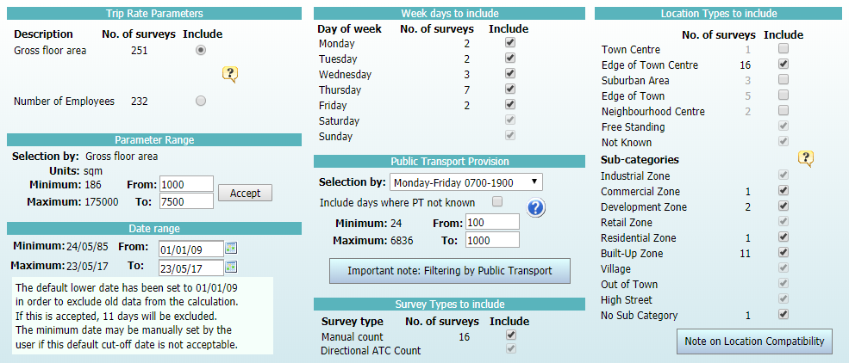
Primary Filtering Page
Notes:
The example used here is for an 02/A office development with a GFA of 4,500m², in an Edge of Town Centre location. Only weekday surveys are wanted and only sites with a decent level of local public transport are required, so a filter of between 100 and 1,000 local transport pass-bys has been used, leaving the above selections.

Slide 17
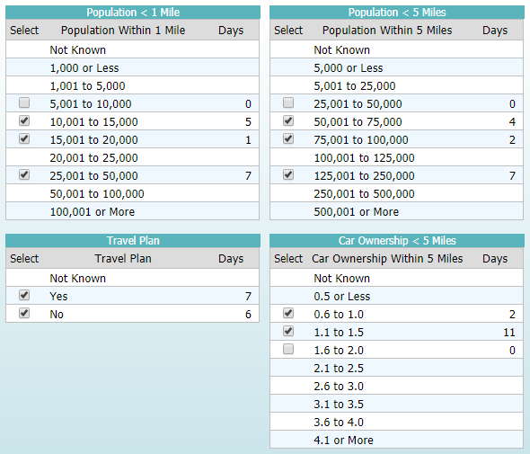
Secondary Filtering Page
Notes:
The hypothetical site has a local population of 25,000 within 1 mile and 125,000 within 5 miles so one site with a local population of less than 10,000 within 1 mile and one site with a local population of less than 50,000 within 5 miles have been deselected. One site with a car ownership level of 1.6 to 2.0 has also been deselected as the hypothetical site has a local car ownership level of 1.0.

Slide 18
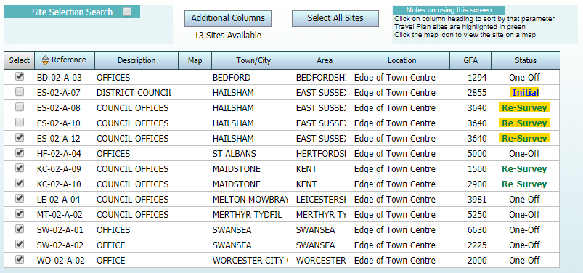
Survey Sample
Notes:
Advanced filtering leaves a survey sample of 13 but, as can be seen above, four of those surveys are for the same site. It is recommended to only include one of these four and the survey to include can be chosen in several different ways. By default, the most recent survey is included. However, it may be preferential to include an older survey if you want to include surveys only from a particular day of the week. It is also possible to include only the busiest survey.

Slide 19
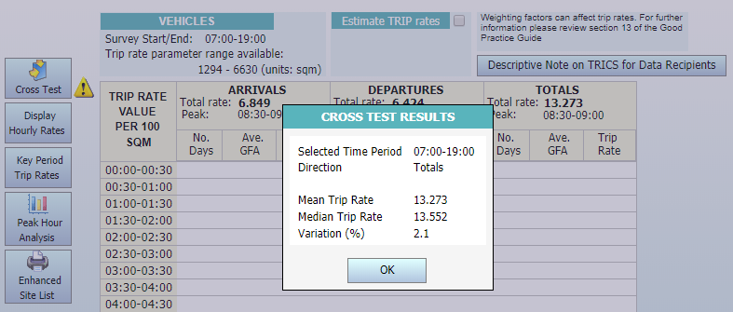
Cross Test
Notes:
The cross test feature compares the Mean figure from the trip rates calculation and the Median figure from the Rank Order list to give a variation figure. A figure of less than 5% is generally seen as a positive though it is important to note this isn’t a fixed figure to show whether data is reliable. However, if the figure is above 5% it can suggest heavy weighting of individual sites within the survey sample which should be investigated.

Slide 20
What to Consider Outside TRICS
Discover more about the surrounding area
Census Data
Socioeconomic Factors
Notes:
It is key to research the local area to your site by looking into census data and socioeconomic factors to properly gain a knowledge of where it is and how it will compare to other sites on the TRICS database.

Slide 21
Elsewhere in TRICS
Logic applies to other land uses
Do not accept sites without investigation
Do not dismiss sites without investigation
Notes:
All of these points throughout the presentation are applicable to all land uses. The most important point is never to include a site in a survey sample without investigating its compatibility and to never exclude a site from a survey sample without having good reason to.

