Slide 1
The 2016 TRICS User Survey and Forthcoming System Developments
Nick Rabbets, Managing Director, TRICS Consortium Limited
Notes:
In this presentation I am going to present the results of the 2016 TRICS User Survey, and go through a few system development ideas that users have given us.

Slide 2
TRICS User Survey & System Developments
User Survey sent out to all TRICS users annually.
This presentation will present the findings of the 2016 User Survey.
Findings are based on a total of 60 responses.
User Assessment of TRICS
Suggested future system developments and research topics discussed.
Notes:
The TRICS User Survey is sent out to all member organisations annually. This year the survey was sent out in March, giving us plenty of time to assess the results prior to the User Meeting. In total there were 60 responses, and these consisted of a user assessment of TRICS along with ideas for future system development and research.

Slide 3
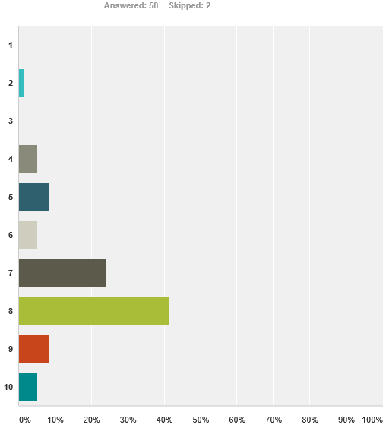
Question 1
“How would you rate the overall usefulness of TRICS and its variety of user options and interactions?”
(1 = very poor, 10 = excellent)
Notes:
Let’s go through the first few questions of the survey, which focused on how users currently find the TRICS system in terms of its every day use. The first question asked “how would you rate the overall usefulness of TRICS and its variety of user options and interactions?” The results are shown from the top of the graph as 1 for very poor, and at the bottom as 10 meaning excellent. The x-axis shows increments of 10% of responses. So, we can see that the highest scoring number out of 10 is 8, with some 40% of responses. However, we can see that we have room for improvement, which is always what we are trying to do at TRICS.

Slide 4
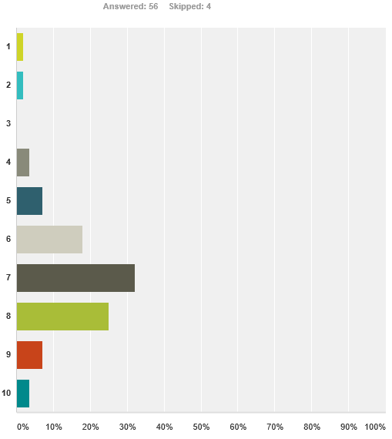
Question 2
“How user friendly and user intuitive do you find the system interface?”
(1 = very awkward, 10 = excellent)
Notes:
Question 2 asked “how user friendly and user intuitive do you find the system interface?” The scores here are quite similar to the previous question, although slightly lower overall, with the highest grouping being 7 out of 10 (around 32% of responses).

Slide 5
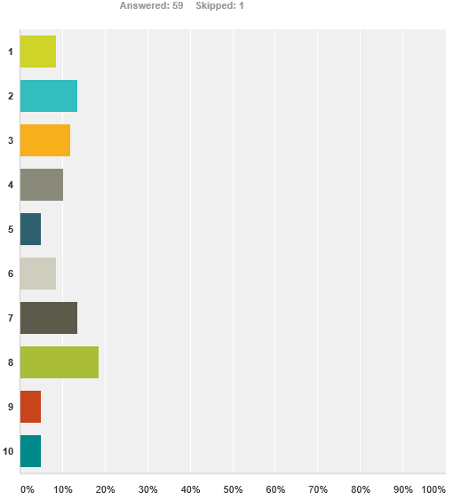
Question 3
“How ‘problem free’ do you find your interactions with TRICS?”
(1 = no problems, 10 = many problems/issues)
Notes:
Question 3 asked “How ‘problem free’ do you find your interactions with TRICS?” The answers to this were very mixed indeed, with no score out of 10 being particularly dominant. This gives the TRICS team an opportunity to ask you today what the problems you experience with TRICS are, perhaps in this afternoon’s open forum session. We would very much like to get to grips with any issues that users have with the system, so now is your chance to have your say.

Slide 6
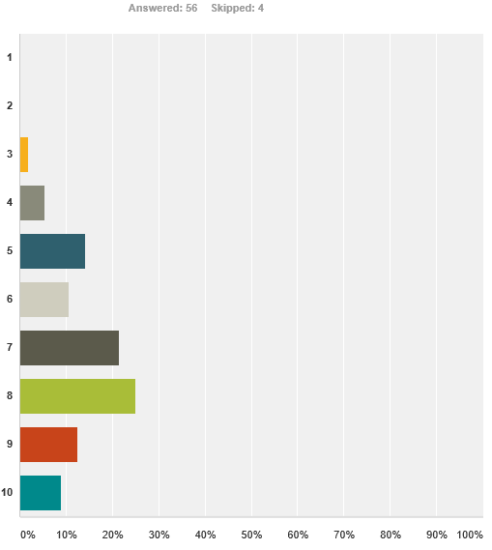
Question 4
“How useful do you find the TRICS Good Practice Guide in understanding the correct use and auditing of TRICS and its data?”
(1 = not useful, 10 = extremely useful)
Notes:
Question 4 now. It asked “how useful do you find the TRICS Good Practice Guide in understanding the correct use and auditing of TRICS and its data?” The Good Practice Guide is very important to us here at TRICS, and we know it is important to the users too. It is good to see that this importance is reflected in the results of this question to a good degree, mostly around the 7 and 8 out of 10 mark, with some variation of course. However, we will be aiming to improve on this result by continuing to listen to users and enhancing and updating the guidance at regular intervals.

Slide 7
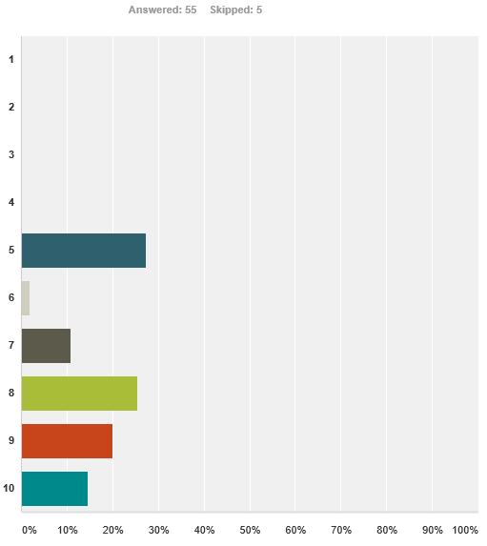
Question 5
“How helpful do you find the TRICS team in responding to your various user/licensing queries?”
(1 = not helpful, 10 = extremely helpful)
Notes:
Question 5 asked “How helpful do you find the TRICS team in responding to your various user/licensing queries?” We are pleased that nobody has marked us as being under 5, with it seems most people quite happy how we deal with your queries. At TRICS we like to offer the best service to all of our users, and this is much valued feedback from you.

Slide 8
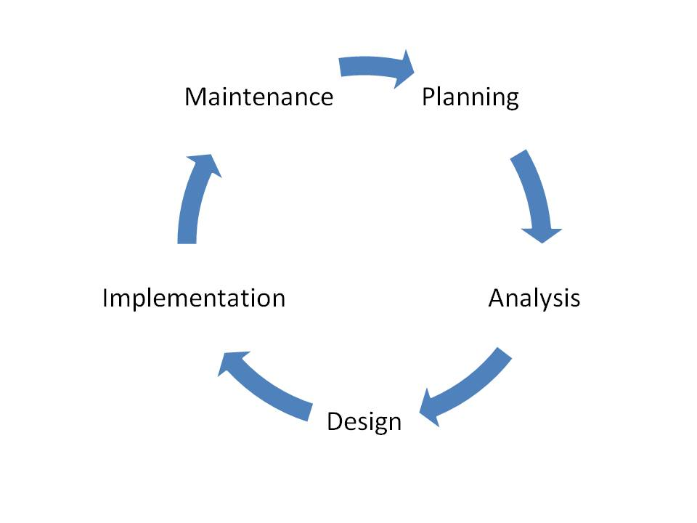
The Systems Development Lifecycle
Notes:
Moving on from the general questions about TRICS, we can now move into system development specifics. We found this interesting diagram online, what is known as the Systems Development Lifecycle. This is particularly appropriate to the ongoing development of TRICS, as it does represent the way in which we work with our users and implement new system features. The way in which our system is interactive with its users in its ongoing development is very important to us, as this unique approach has allowed us to evolve the system over 27 years now.

Slide 9
Analysis of Selected System Developments Suggested by Users
“Include a system whereby you can quickly PDF/print a list of all selected sites, showing the site characteristics (such as number of parking spaces, PTAL (for London), etc).”
TRICS Response: We could introduce a “Selected Sites Summary” that precedes trip rate calculation outputs with site and development details.
Notes:
Here are some selected system development ideas from users from the 2016 User Survey, and our initial thoughts on these. Once we have had our discussions today, we will go away and formulate a programme of system development to take place over the second half of this year. The first suggestion is as follows. “Include a system whereby you can quickly PDF/print a list of all selected sites, showing the site characteristics (such as number of parking spaces, PTAL (for London), etc).” This is an interesting suggestion, as we could indeed introduce something called a “Selected Sites Summary” that precedes trip rate calculation outputs with some key site and development details. This is one that we will be certainly looking into.

Slide 10
Analysis of Selected System Developments Suggested by Users
“TRICS surveys should count servicing vehicles separately, showing inbound and outbound numbers per hour by vehicle type.”
TRICS Response: We already collect this information for sites in Greater London as part of the TfL/TRICS agreement, we could expand this to other regions as this has now been piloted successfully.
Notes:
The next suggestion is as follows. “TRICS surveys should count servicing vehicles separately, showing inbound and outbound numbers per hour by vehicle type”. Well the good news is that we already do this for multi-modal surveys in Greater London, a result of the April 2014 agreement between Transport for London and TRICS. This count screen shows inbound and outbound servicing vehicles by car, LGV, and OGV(1) and (2), and over the last couple of years we have piloted this successfully. We are now able to look into what it would take to introduce these counts more generally across the regions. This will be investigated.

Slide 11
Analysis of Selected System Developments Suggested by Users
“Provide full details on nearby public transport links for sites.”
TRICS Response: At the moment we include information on local bus and rail facilities, in terms of services and frequencies. What kind of further information would users like to see?
Notes:
Here is the next suggestion. “Provide full details on nearby public transport links for sites”. This raises a question – just what type of additional information would users like to see added to what we collect at the moment? We currently collect information on bus and train frequencies, destinations and journey times, along with a public transport services summary table showing the total number of buses and trains locally. Is there more that you would like to see? One to discuss this afternoon at our open forum session I think.

Slide 12
Analysis of Selected System Developments Suggested by Users
“Introduce the filtering of sites by PTAL level for surveys in Greater London.”
TRICS Response: In recent years we have collected PTAL information for our Greater London sites. We could introduce a PTAL filter for London-only datasets.
Notes:
The next suggestion is “introduce the filtering of sites by PTAL level for surveys in Greater London”. Now it is true that we have been collecting PTAL scores for new Greater London sites entering the TRICS database over the last few years. The question we have is, is it now time to introduce a filtering option for London-only datasets. Again, something we can discuss later.

Slide 13
Analysis of Selected System Developments Suggested by Users
“Provide more information for sites with operational Travel Plans.”
TRICS Response: It may be time for the information collected for TRICS SAM sites to be reviewed, as there are many residential sites being surveyed and often Travel Plan elements on the database do not correspond fully.
Notes:
Here is the next user suggestion. “Provide more information for sites with operational Travel Plans.” We introduced the Travel Plan data section for TRICS SAM surveys back in 2005, over 10 years ago now, and perhaps it is now time for us to re-assess the information that is contained within this part of the database. For example, many of our SAM surveys are residential in nature, and the Travel Plan data section does sometimes seem more geared up for employment land uses such as offices etc. We could possibly look at introducing a separate set of information for residential sites, for example, or enhancing and updating the information within the current Travel Plan section generally. We will need to sit down and think about how these changes could be made. However, existing sites on the database would not be changing, any changes would only apply to new data entering the system.

Slide 14
Analysis of Selected System Developments Suggested by Users
“When deselecting sites, permit more than one site to be deselected at a time without having to input a reason for each individual site deselection.”
TRICS Response: This is a good suggestion. We could amend the system so that a common explanation could be used for a group of deselected sites.
Notes:
Here is the next suggestion. “When deselecting sites, permit more than one site to be deselected at a time without having to input a reason for each individual site selection.” This is a good idea, and a way for users to save time. At the moment, users have to physically type in a reason for each individual site deselection during the trip rate calculation process. What we could do is allow users to copy a reason at the click of a button to speed things up. This is something the TRICS team will be looking at, as we are always looking to make the system more efficient and user-friendly.

Slide 15
Analysis of Selected System Developments Suggested by Users
“Include the name of the local planning authority for each new site input into TRICS.”
TRICS Response: The local planning authority at the time the survey took place could be added, perhaps as an addition to the AREA and REGION items on the Site Details screen.
Notes:
The next suggestion is “include the name of the local planning authority for each new site input into TRICS”. This is a good idea, we could put the planning authority (at the time of the survey being undertaken of course) into the database records for individual sites (in the Site Details screen), perhaps as an addition to the AREA and REGION items that are currently shown. This would of course only apply to new sites entering the database.

Slide 16
Analysis of Selected System Developments Suggested by Users
“Provide a summary table of trip rates for key periods such as AM and PM road peaks, by mode, to accompany the existing results table.”
TRICS Response: An interesting idea. Above the 24-hour trip rate results table we could summarise 0800-0900, 1700-1800, etc. Perhaps we could also have user-defined periods summarised too.
Notes:
The final suggestion that we are covering in this presentation is as follows. “Provide a summary table of trip rates for key periods such as AM and PM road peaks, by mode, to accompany the existing results table”. This is another interesting idea. Above the 24-hour standard trip rate calculation results table, we could insert summary trip rates for road peaks such as 0800-0900 and 1800-1900, plus possibly some user-defined periods that users could select prior to undertaking the calculation. We would need to look at the technicalities and the feasibility of the such an addition to the system, but we will have a look and see if this is achievable without crowing the screen too much.

Slide 17
Future TRICS Research Ideas
Notes:
Moving on now from system development to research ideas. Over the years, TRICS has commissioned and undertaken a variety of research projects, the most recent one being the December 2014 publication “Pass-By & Diverted Trips”. Our User Survey always asks for ideas about potential future projects, and we have picked a few suggestions out to gather further food for thought at this afternoon’s open forum.

Slide 18
User Survey Research Ideas Summary
Effectiveness of Travel Plans and their targets over time.
A study of the relationship between on-site parking availability and vehicle trip rates, particularly for residential developments.
The use of Car Clubs. Who, how far and how frequent, and what is the replacement of car ownership?
A comparison of forecast trip rates compared to actual trip rates post construction.
Notes:
The suggestions from the users were varied and quite interesting. The first one was “the effectiveness of travel plans and their targets over time”. We have been undertaking quite a few SAM surveys over recent years, and there is quite a bit of data there that could be used for something like this. Then we have “a study of the relationship between on-site parking availability and vehicle trip rates, particularly for residential developments”. Again, there is a wealth of data for Houses Privately Owned sites in the TRICS database. There is a suggestion of research into Car Clubs, and how successful they may be in terms of replacing car ownership, and a comparison of forecast trip rates compared to actual trip rates post-construction, something that does come up quite often in the User Survey.

Slide 19
User Survey Research Ideas Summary
A review of whether changes in the food retail sector (in particular Discount Food Stores) have affected trip rates.
Research into large mixed use residential-led sites, including internal capture figures.
The effect of mezzanine floors on trip generation at non-food retail stores.
Geographical variation in trip rates.
Notes:
There are some other ideas here. The first one is “a review of whether changes in the food retail sector (in particular Discount Food Stores) have affected trip rates”. This one came up a few times, and given stores such as Aldi and Lidl becoming what we might call more “mainsteam” in recent years perhaps this is something worth looking into. Then there is research into large mixed use residential-led developments and internalisation, the effect of mezzanine floors on trip generation at non-food retail stores (as mezzanine floors seem to have become a growing phenomenon), and geographical variation in trip rates.

Slide 20
User Survey Research Ideas Summary
LSTF – Before and after surveys.
A study on the impacts of congestion on peak hour trip rates, including city centre sites such as retail.
Food shopping linked trips – What proportion of food trips are made as part of another journey?
A study of multipurpose residential trips.
Notes:
Here are a few more research ideas. We start off with LSTF – before and after surveys, a study on the impacts of congestion on peak hour trip rates (including city centre sites such as retail), and food shopping linked trips (what proportion of food trips are made as part of another trip?). The final user suggestion is a study of multipurpose residential trips, presumably meaning people leaving their residential homes and undertaking one or more trip activities before returning home again, something that might be tackled by front door interviews perhaps. We will consider all of these research ideas for potential future projects.

Slide 21
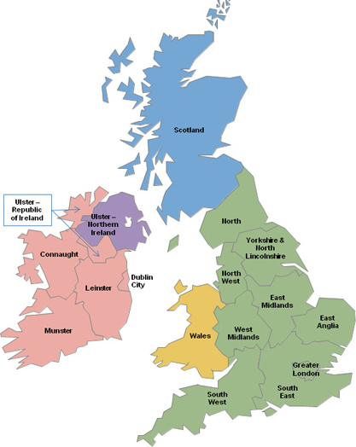
Where would you like to see more TRICS surveys (10 being maximum priority)?
East Midlands 7.4
South East 7.3
South West 7.2
West Midlands 7.2
Yorkshire & N. Lincs 7.2
North West 7.1
North 7.1
East Anglia 6.9
Greater London 5.5
Notes:
There were a few other questions at the end of the User Survey that I can just run through with you. We asked users to score the 17 regions of TRICS in order of priority for future surveys (scores out of 10), and the averages are shown here. This year the highest scoring region was East Midlands, with an average of 7.4 out of 10. Some other familiar regions are again ranked highly, with South East in second place. We will use this information when preparing our 2017 data collection programme allocations across the regions, so you can be sure that your feedback is definitely used as we move forwards.

Slide 22
Where would you like to see more TRICS surveys (10 being maximum priority)?
Wales 5.1
Scotland 3.6
Ulster (N. Ireland) 2.5
Connaught 2.3
Leinster 2.3
Ulster (Rep. of Ireland) 2.3
Greater Dublin 2.1
Munster 2.1
Notes:
Here is the second part of the regional rankings. Although it is as expected with the Irish regions at the bottom of the list, we are still committed to covering all 17 regions in our annual data collection programmes. This is all about allocation the correct proportions of the programme to the regions in highest demand.

Slide 23
Top 10 Land Use Categories for Future Surveys – Selected by the Users
Discount Food Store 26
Industrial Estate 24
Food Superstore 20
Business Park 20
Industrial Unit 20
Warehousing (commercial) 20
Houses Privately Owned 20
Office 19
Affordable/Local Authority Houses 19
Retirement Flats 18
Notes:
Here we have the top ten land use sub-categories where more surveys are wanted by users. This year, the most popular land use is Discount Food Store, which is not that surprising seeing as such stores have become much more “mainstream” in recent years. Again, we will use this information to allocate our survey targets for 2017, and of course we will still be covering a wide variety of development types as per usual.

Slide 24
Some Ideas for new Land Use Categories in TRICS
Café
Drive-Through Coffee Shop
DotCom Warehousing
Sports Club (e.g. rugby club)
Energy from Waste/Waste Transfer
Continued Care Residential Communities
Discount Mixed Retailer (e.g. B&M)
Town Centre Cinema
Notes:
We are onto the last couple of slides now. Here we have some user suggestions for future additions to the land use types on the TRICS database. What do you think about some of these? Do you have some suggestions of your own? Perhaps we can discuss this at the open forum this afternoon.

Slide 25
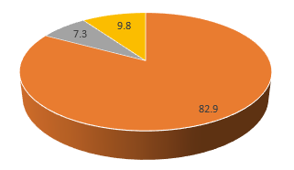
Final Question
“Which version of the TRICS system do you use?”
Online Version Only: 82.9%
Offline Version Only: 7.3%
Both Versions: 9.8%
50% Offline Only Users can use
Online System but have historically
used Offline Version.
100% of Users using Both Versions
use Online System more than 75%
of the time.
Notes:
And finally, we asked the users “which version of the TRICS system do you use?”. We wanted to establish a baseline for the use of the online system, offline system, and both together, and here are the results. It would seem that around 83% of users used the online version only, a huge majority. This is something for us to consider as we continue to develop the system, and, eventually, look towards the development of TRICS 8 a few years down the line.

Slide 26
QUESTIONS
Please keep your Systems Development and Research ideas for the Afternoon Forum Session, or see Ian or me during Coffee & Lunch.

